Slide 1
Infectious disease has many faces: are they all the same?
Nicholas Michalak & Joshua Ackerman
Notes:
Work with josh, how do people perceive infectious disease in faces?

Slide 2
Why do people perceive pathogen threats in other people?
Notes:
helps to understand why people look out for infectious disease at all

Slide 3
Infectious disease is an enduring, predictable feature of the environment MURRAY & SCHALLER, 2015
Notes:
people care about infectious disease because it's been a part of their environment for a long time
not just part of the environment but a threatening, consequential part

Slide 4
Infectious disease
Likely killed more people than all wars, noninfectious diseases, and natural disasters combined Inborn & Brown, 1990
Leading cause of death worldwide, especially in low-income countries and in young children World Health Organization, 2018
Notes:
has killed many people
continues to kill people

Slide 5
Biological systems evolved to detect and reduce pathogen threats NESSE, 2005; MURRAY & SCHALLER, 2015
Notes:
because infectious disease is enduring, predictable, and threating to our survival ...

Slide 6
How do perceivers detect pathogen threats in other people?
PERCEIVABLE CUES
Notes:
data I'm presenting today speaks to how people detect pathogen threats
there are many ways people detect pathogen threats, but all of them rely on perceivable cues

Slide 7
MUMPS
MEASLES
23/25 (92%) OF MOST DEADLY INFECTIOUS DISEASES CAUSE SYMPTOMS VISIBLE IN THE FACE. RYAN, OATEN, STEVENSON, & CASE, 2012; WOLFE, PANOSIAN, & DIAMOND, 2007
YELLOW FEVER
Notes:
not just any perceivable cues but cues that are actually correlated with infectious disease
many of the most deadly infectious diseases cause visible symptoms in the face
so the face is a rich source of information about pathogen threats

Slide 8
Disease detection inputs: proper vs. actual
ACTUAL DOMAIN
Proper Domain. class of inputs the module was designed by natural selection to process Barrett & Kurzban, 2006; Sperber, 1994
Examples: contagious pox and rashes
Actual Domain. broader class of inputs than the type for which certain modular systems evolved
Examples: acne, burn scars
PROPER DOMAIN
Notes:
But more facial features look like infectious disease than are actually diagnostic of infectious disease
You can imagine a universe of possible facial features that fall within two overlapping domains
There's proper domain of facial features our disease detection system evolved to process (for example …)
And there is a broader, actual domain that includesf facial features that look similar enough to real infectious disease cues that they can be processed (for example …)

Slide 9
Wide variability in infectious disease symptoms (and look-alikes): detection errors are inevitable HASELTON & NETTLE, 2006; MURRAY & SCHALLER, 2015
Notes:
variability in diseases
variability in symptoms
diseases change and evolve
Variability in what looks like disease
Facial features are imperfect diagnostic cue for infection
if you rely on only these kinds of cues, errors are inevitable

Slide 10
Anomalous feature Overgeneralization bias reduces the most costly errors HASELTON & NETTLE, 2006; MURRAY & SCHALLER, 2015
SMOKE DETECTOR PRINCIPLE
Notes:
But not all errors have the same consequences for evolutionary fitness
For the same reason it's more costly to ignore a true fire than to respond to a false fire
in many cases, it's more costly to ignore a truly infected person than to avoid a healthy person
So we’ve likely evolved an …

Slide 11
PEOPLE ASSOCIATE ANOMALOUS FACIAL FEATURES WITH INFECTIOUS DISEASE MURRAY & SCHALLER, 2015
OBESITY
PARK, SCHALLER, & CRANDALL, 2007
FACIAL DISCOLORATION
RYAN, OATEN, STEVENSON, & CASE, 2012
OLD AGE
DUNCAN & SCHALLER, 2009
Notes:
A growing body of empirical findings suggest people do overgeneralize, they do make errors when benign, anomalous features just kinda look like disease
In experiments and correlational studies, people associate obesity, facial birthmarks, and old age with infectious disease

Slide 12
researchers often test one anomalous facial feature at a time: feature present vs. absent
Disfigured vs. Normal Ackerman, et al., 2009
Obese vs. Normal Miller & Maner, 2012
Old vs. Young Duncan & Schaller, 2009
Notes:
Limitation to research
when they test psychological or behavioral effects of anomalous features, they pick one feature and compare responses when they feature is present or absent
for example ...
this kind of design is a good first step in testing the anomalous feature overgeneralization hypothesis, but ...

Slide 13
Are all anomalous features equally associated with infectious disease?
BRUISES AND CUTS
OBESE
INFECTIOUS DISEASE
BURN SCAR
OLD
ACNE
PORT WINE STAIN BIRTHMARK
Notes:
these designs ignore variability in these kinds of features
they imply a weakly held assumption that these features are equally associated with infectious disease
could be the case, but ...

Slide 14
Which facial feature diagnoses infectious disease?
Which facial feature looks like an infectious disease?
NEITHER
Notes:
Here’s an example: obesity and port wine stain birth mark. Which feature diagnoses infectious disease? Take a second to answer in your head ... the answer is neither of them. OK but which feature looks like an infection?
my point is that it's entirely plausible for you to both endorse the belief that neither of these people are actually infectious yet you still think of feel that one person looks more disease-like than the other.

Slide 15
Are some anomalous facial features more strongly associated with infectious disease than others?
Notes:
My question is …

Slide 16
stronger association with infectious = better proper domain match
Hypothesis 1. Anomalous faces are more strongly associated with Infectious concepts (compared to “Average” faces)
Hypothesis 2. “Disfigured” faces are more strongly associated with Infectious concepts (compared to Obese faces)
Notes:
Hypothesis 1. this is the same hypothesis that researchers have tested already
Hypothesis 2. this hypothesis stems from the idea that some cues better match the proper input domain than others

Slide 17
All studies use the Implicit association test
Classification task measures strength of automatic associations Greenwald, Nosek, & Banaji, 2003
Classification response keys change during the task (e.g., African American = Good/Bad)
Faster reaction time = stronger association
Example: Race IAT
Notes:
4 categories, 2 response keys

Slide 18
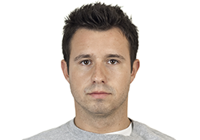
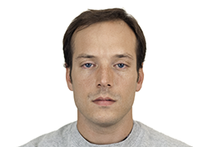
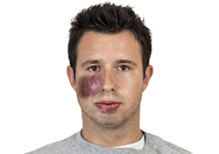
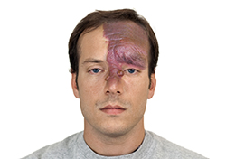
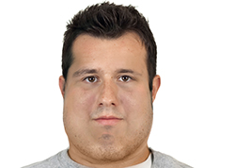
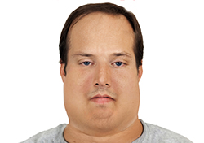
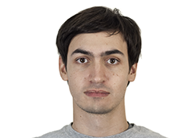
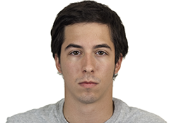
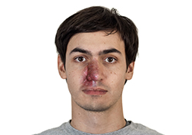
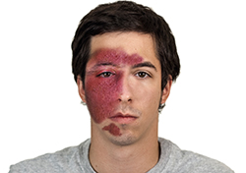
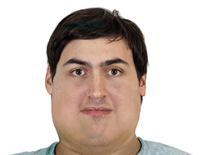
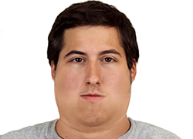
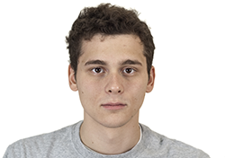
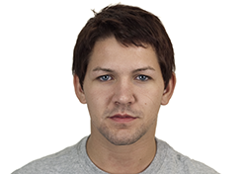
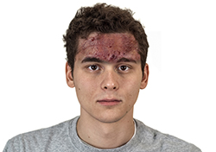
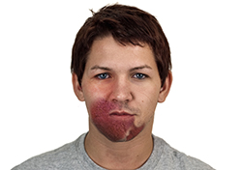
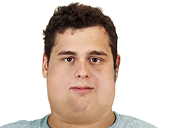
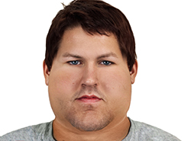
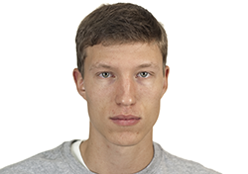
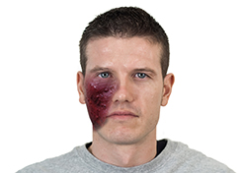
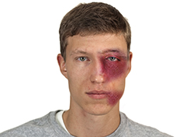
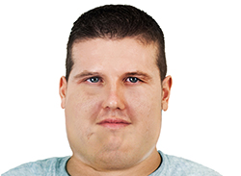
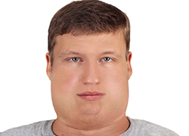
Original
Disfigured
Obese
Stimuli adapted from the Chicago Face Database
Ma, Correll, & Wittenbrink, 2015
Notes:
But we’re studying anomalous cues, not race. All studies use custom anomalous feature stimuli adapted from …
I’d love to talk after about these stimuli and stimuli sampling in psychology in general if interest

Slide 19
IAT Studies layout
Study 1
(like past research)
Study 2
(really test our question)
Study 3
(test alternatives)
“AVERAGE”
OR
OBESE
“AVERAGE”
OR
“DISFIGURED”
OBESE
OR
“DISFIGURED”
OBESE
OR
BURN SCAR
OBESE
OR
“DISFIGURED”
INFECTIOUS
OR
HARMLESS
INFECTIOUS
OR
HARMLESS
INFECTIOUS
OR
HARMLESS
INFECTIOUS
OR
HARMLESS
LAZY
OR
HARMLESS
Notes:
First studies were designed to mimic past research; they test whether anomalous feature are more associated with infectious concepts compared to average faces
Second studies directly test our hypotheses by including both anomalous feature in the same task
Last studies test alternative explanations about how participants interpret the stimuli and also general negativity

Slide 20
Study 1 goals
Participants categorize faces with or without anomalous cues
Categorize Infectious or Harmless words
Compare Obese and “Disfigured” strengths of association with Infectious concepts

Slide 21
Study 1
U of M Undergraduates N = 273 (114 Men, 167 Women)
(Power > 80% for d = 0.20)
Anomalous Feature IAT
Two Conditions (Random Assignment)
Average vs. Obese
Average vs. “Disfigured”
Instructions, including category definitions
Anomalous Feature IAT
Questionnaires

Slide 22
FASTER reaction time = stronger association

Slide 23
Are anomalous faces automatically associated with Infectious concepts?

Slide 24
2.5
2.0
1.5
Reaction Time (Standardized)
1.0
0.5
0.0
Anomaly + Harmless
Anomaly + Infectious
“Congruent” main effect, p < .001
“Congruent” x Order interaction, p < .001
Notes:
People took longer to categorize anomalous facial features with harmless concepts than they did to categorize anomalous facial features with infectious concepts
this suggests people associate anomalous feature with infectious concepts, at least more than with harmless concepts
But this test ignores which anomalous features participants saw

Slide 25
Does strength of association depend on the type of anomalous feature (obese or “disfigured”)?
Notes:
so my second question is whether this matters ...

Slide 26
Anomaly = Obese
Anomaly = Disfigured
2.5
SMALLER
BIGGER
2.0
1.5
Reaction Time (Standardized)
1.0
0.5
0.0
Obese + Harmless
Obese + Infectious
Disfigured + Harmless
Disfigured + Infectious
“Congruent” x Cue Type interaction, p < .001
“Congruent” x Cue Type x Order interaction, p = .034
Notes:
People were faster at categorizing obese faces when they were paired with infectious words
People were faster at categorizing disfigured faces when they were paired with infectious words
Look at these independently you’re limited in what you can infer about anomalous features and their association to infectious concepts
Compare them and you learn something about stimuli variability and strength of association: disfigured faces appear more strongly associated with infectious concepts

Slide 27
Study 1 takeaways
Anomalous faces were automatically associated with Infectious concepts
Compared to Obese faces, “Disfigured” faces were more strongly associated with Infectious concepts

Slide 28
Study 2 goals
Have participants categorize both Obese and “Disfigured” faces in the same IAT
Participants directly experience key comparison

Slide 29
Study 2
U of M Undergraduates
N = 255 (103 Men,152 Women)
(Power > 80% for d = 0.20)
Combined Anomalous Feature IAT
Obese vs. “Disfigured” (One Condition)
Instructions, including category definitions
Combined Anomalous Feature IAT
Questionnaires

Slide 30
Are obese and “disfigured” faces equally associated with infectious concepts?

Slide 31
2.0
1.5
Reaction Time (Standardized)
1.0
0.5
0.0
Obese + Infectious
Disfigured + Infectious
“Congruent” main effect, p < .001
“Congruent” x Order interaction, p < .001
Notes:
compared to obese faces, people were quicker at categorizing disfigured faces when they were paired with infectious concepts

Slide 32
Study 2 takeaways
Participants categorized both Obese and Disfigured faces
Like in Study 1, compared to Obese faces, Disfigured targets were more strongly associated with Infectious concepts

Slide 33
Study 3A and 3B questions
Do participants believe “Disfigured” targets are truly benign (not caused by infections)?
Do participants associate “Disfigured” targets with all negative categories?
Notes:
We designed study 3 to test alternative explanations that stem from two questions, one

Slide 34
Study 3A and 3B goals
3A: Replace “Disfigured” category with Burn Scar category and tell participants scars are benign (not infectious)
3B: Replace Infectious category with Lazy category van Leeuwen, Hunt, & Park, 2015
Notes:
lazy = poor cooperation partner
Poor cooperation partners with low self-control

Slide 35
Study 3A and 3B
U of M Undergraduates
N = 131 (47 Men, 87 Women)
(Power > 80% for d = 0.25)
Anomalous Feature IAT
Obese
or
Harmless
Disfigured
or
Lazy
Obese
or
Harmless
Burn Scar
or
Infectious
Two Conditions (Random Assignment)
Obese vs. Burn Scar
Harmless vs. Lazy
Instructions, including category definitions
Anomalous Feature IAT
Questionnaires

Slide 36
Are obese and (BENIGN) BURN SCAR faces equally associated with infectious concepts?
Notes:
I’m picking one pair of cues to compare: obesity and facial disfigurement. My hypothesis is …

Slide 37
2.0
1.5
Reaction Time (Standardized)
1.0
0.5
0.0
Obese + Infectious
Burn Scar + Infectious
“Congruent” main effect, p < .001
“Congruent” x Order interaction, p < .001

Slide 38
Are obese and disfigured faces equally associated with lazy concepts?

Slide 39
2.0
1.5
Reaction Time (Standardized)
1.0
0.5
0.0
Obese + Lazy
Disfigured + Lazy
“Congruent” main effect, p < .001
“Congruent” x Order interaction, p < .001
Notes:
these data are inconsistent with the hypothesis that disfigured faces are always more threatening -- depends on the threat

Slide 40
Study 3 takeaways
Like “Disfigured” faces in Studies 1 & 2, compared to Obese faces, Burn Scar faces were more strongly associated with Infectious concepts
Compared to “Disfigured” faces, Obese faces were more strongly associated with Lazy concepts

Slide 41
empirical takeaways
Studies 1 & 2. Obese and “Disfigured” associated with Infectious concepts, but “Disfigured” more strongly associated
Studies 3A & 3B. Effects not easily explained by misinterpreting “Disfigured” stimuli or by general negative associations

Slide 42
conceptual takeaways
People perceive a variety of cues as (and mistake them for) infectious disease threats—but people don’t perceive all such cues as equally threat-like.

Slide 43
conceptual takeaways
Cognitive and perceptual systems (not just disease detection) operate on proper and actual domain stimuli
Stronger tests require direct comparisons between candidate stimuli—not just feature present vs. feature absent

Slide 44
Evolutionary social psychology lab
Lab & Friends
Research assistants
Josh Ackerman
Oliver Sng
Iris Wang
Wilson Merrell
Soyeon Choi
Spencer Dobbs
Yuching Lin
Emily Jones
Isabel Osgood
Tyler Aman
Megan Mulhinch
Emily Dyke
Shyryn Borgol
Michelle Conklin
Amanda Yoo
Briana Travis
Briana Bowen
@umesplab

Slide 45
THANK YOU
nickmichalak.com
@nmmichalak
Slides. https://osf.io/2d96k/ or https://osf.io/view/HBES2018/

Slide 46
Statistical model Wolsiefer, Westfall, & Judd (2016)
Fixed effects
“Congruent” (-0.5 = “Congruent” trials, 0.5 = “Incongruent” trials)
Order (-0.5 = “Incongruent” 1st, 0.5 = “Congruent” 1st)
Word vs. Face (-0.5 = Word, 0.5 = Face)
Word Type (-0.5 = “Harmless”, 0.5 = “Infectious”)
Face Type (-0.5 = “Anomalous”, 0.5 = “Average”)
Cue Type (-0.5 = “Disfigured”, 0.5 = “Obese”)
“Congruent” x Order x Cue Type (Word vs. Face + Word Type + Face Type)
Random effects
Participant intercepts, Participant “Congruent” slopes, intercept-slope correlation
Stimuli intercepts, Stimuli “Congruent” slopes, intercept-slope correlation
Power analysis.
http://jakewestfall.org/pangea/

Slide 47
Disfigured more infectious or obese more harmless? (study 1)
Harmless
Infectious
2
Average or Disfigured
1
0
Reaction Time (Standardized)
2
Average or Obese
1
0
Average
Obese
Disfigured
Average
Obese
Disfigured

Slide 48
Disfigured more infectious or obese more harmless? (study 2)
Harmless
Infectious
2.5
2.0
1.5
Reaction Time (Standardized)
1.0
0.5
0.0
Obese
Disfigured
Obese
Disfigured

Slide 49
Harmless | Infectious | Lazy
Tape | Epidemic | Procrastinating
Cardboard | Germs | Careless
Typewriter | Plague | Indifferent
Dryer | Contagion | Inactive
Bran | Flu | Sluggish
Teaspoon | Virus | Neglectful
Sod | Parasite | Passive
Ground | Bacteria | Slacker

Slide 50
Trait | Definition | Studies
Harmless | not harmful or injurious; not likely to irritate or offend; benign or innocuous | 1; 2; 3.1
Infectious | causing or communicating infection; tending to spread (disease) from one to another; contagious | 1; 2; 3.1
Lazy | unwilling to work or use energy; averse or disinclined to work, activity, or exertion; indolent | 3.2
Obese | obesity means having too much or excessive body fat, more than what's considered healthy for one's height. obesity happens over time when one eats more calories than one uses. | 3.1
Burn Scar | burns cause skin cells to die. damaged skin produces a protein called collagen to repair itself. as the skin heals, thickened, discolored areas called scars form. some scars are temporary and fade over time. others are permanent | 3.1

Slide 51
Rating | Definition
Germy | full of germs; germ infested; appearing either sick or contaminated
Disfigured | problematic or damaged physical appearance; blemished; deformed; impaired (as in beauty) by deep and persistent injuries or developmental problems
Heavy | physical weight; having excess flesh; wide or thick with fat (not muscle), appearing to weigh more than the average person
Fat | notable for having an unusual amount of fat; having too much flabby tissue
Unpleasant | not pleasant or enjoyable; causing discomfort, unhappiness, or revulsion
Upset | emotionally distressed or disturbed
Happy | feeling or showing pleasure or contentment; pleased or glad about a particular situation, event, etc.
Clear | easy to see or perceive; easily visible; free from obscurity or ambiguity
Realistic | the quality of being very much like real life; resembling real life
Edited/photoshopped | to prepare a photo to be seen in a particular way; to change, move, or remove parts of a photo

Slide 52
Germy
Disfigured
Heavy
Fat
Unpleasant
Upset
Happy
Clear
Realistic
Photoshopped
-6
-5
-4
-3
-2
-1
0
1
2
3
4
5
6
Mean Difference
(Disfigured - Obese)
Pretest
MTurk
N =200 (82 Men,100 Women)
Edited/Photoshopped, p = .068

Slide 53
do people who are more chronically averse to germs dislike fat people more?

Slide 54
do people who perceive themselves as more infectable dislike fat people more?

Slide 55
Obesity isn’t such a clear infectious disease cue
Few (if any) infections cause obesity
Being overweight is sometimes associated with health, wealth, and higher social status McLaren, 2007
For ancestral hunter-gathers, it was adaptive to be moderately overweight in case of food shortages King, 2013; Pinel, Assanand, & Lehman, 2000

