Slide 1
Can anger cue coalition membership?
Nick Michalak
Notes:
Hi, I’m Nick Michalak. I want you to take a second to think about an angry person.

Slide 2
Notes:
We typically think about anger like a self-centered and antisocial emotion. Under most circumstances, this guy’s anger looks like bad news. But I want to show you a situation where you'll probably interpret anger a little differently.

Slide 3
Notes:
So, I'm using George here to make my main point:

Slide 4
Anger is easily perceivable, and it’s diagnostic in context.
Violating behavior
Angry reaction
Threatened punishment
Group approval
DeScioli & Kurzban, 2013; Haidt, 2003; Kurzban, Tooby, & Cosmides, 2011; Van Kleef, 2009
Notes:
Anger is perceivable and diagnostic in context. In this case, George’s reaction tells us that he cares about movie etiquette. Two dudes were being disruptive and crude. George got angry about it and threatened to punish them. And the audience clapped, which suggests they also care about movie etiquette and punishing people who don't follow it; they thought angry George was being a good citizen.
Overall, this scene nicely depicts what some good research tells about anger:

Slide 5
Anger can diagnose shared values + desirable intentions
Depends on what they’re angry about
Communicates moral concern
Motivates costly punishment
Associated with costly and direct aggression
Signals that threats are credible
Fischer & Roseman, 2007; Gutierrez & Giner-Sorolla, 2007; Hutcherson & Gross, 2011; Kupfer & Giner-Sorolla, 2017; Molho et al., 2017; Reed, DeScioli, & Pinker, 2014; Seip, Van Dijk, & Rotteveel, 2014
Notes:
Anger can diagnose shared values and desirable intentions. Anger can communicate moral concern
Anger can motivate costly punishment and costly and direct aggression And anger can signal that threats are credible
Of course, under many circumstances, these are selfish or antisocial, but how we interpret someone else's anger depends on what they're angry about.

Slide 6
We designed a study to test whether perceivers ever want to affiliate with angry people
Rated 24 behaviors on moral wrongness
1
Rated affiliation intentions toward 24 bystanders who witnessed the same 24 behaviors
2
Completed other questionnaires (individual differences)
3
Notes:
So we designed a study to test whether perceivers ever want to affiliate with angry people. Participants rated 24 behaviors on moral wrongness (a proxy for what they value) Then they rated affiliation intentions toward 24 bystanders who witnessed the same 24 behaviors they rated on wrongness. Then they completed other questionnaires which I’m not going to talk about.

Slide 7
Rated 24 behaviors that violated Moral Foundations
Emotional Care
Physical Care
Fairness
Liberty
Authority
Loyalty
Sanctity
Neutral
Moral Foundations Vignettes
Clifford, Iyengar, Cabeza, & Sinnott-Armstrong, 2015
These didn’t violate anything
Notes:
In the first part of the study, they rated 24 behaviors that violated moral foundations.
As a reference point, we also gave them neutral behaviors that didn’t violate anything.

Slide 8
Racially diverse affective expression (RADIATE) Conley et al., 2018
NEUTRAL White Men
NEUTRAL White Women
Rated some bystanders who expressed NEUTRAL
Notes:
In the second part, participants rated bystanders who witnessed those same behaviors. Some bystanders looked Neutral.

Slide 9
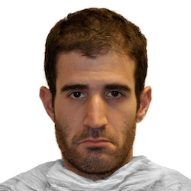
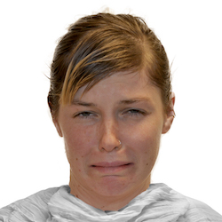
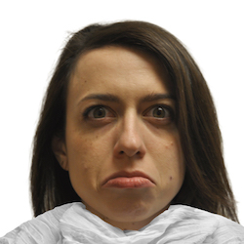
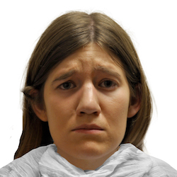
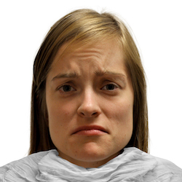
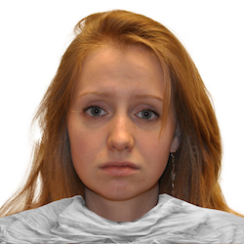
Racially diverse affective expression (RADIATE) Conley et al., 2018
SAD White Men
SAD White Women
Rated some bystanders who expressed SADNESS
Notes:
Others looked Sad.

Slide 10
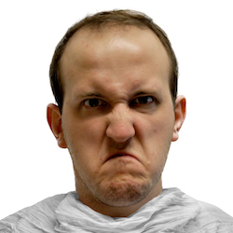
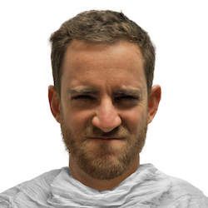
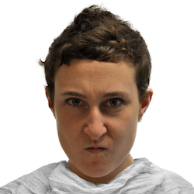
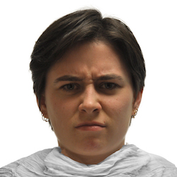
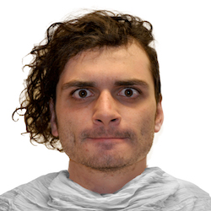
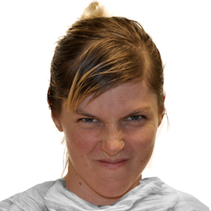
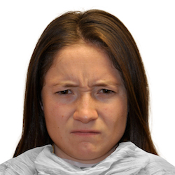
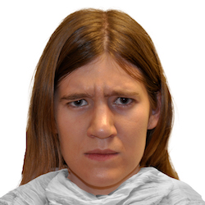
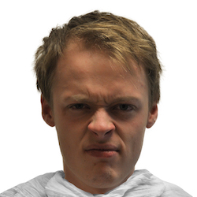
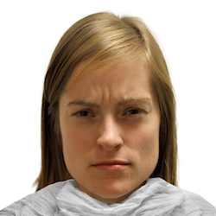
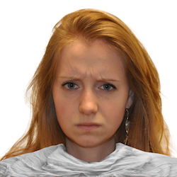
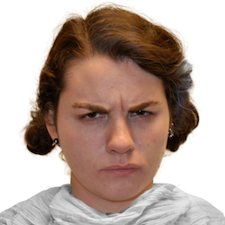
Racially diverse affective expression (RADIATE) Conley et al., 2018
ANGRY White Men
ANGRY White Women
Rated some bystanders who expressed ANGER
Notes:
And others looked Angry.

Slide 11
“This bystander (pictured below) sees a man turn his back and walk away while his boss questions his work.”
“This bystander (pictured below) sees a politician using federal tax dollars to build an extension on his home.”
“This bystander (pictured below) sees a woman spanking her child with a spatula for getting bad grades in school.”
Example
“You see a woman spanking her child with a spatula for getting bad grades in school.”
“You see a politician using federal tax dollars to build an extension on his home.”
“You see a man turn his back and walk away while his boss questions his work.”
“I like this person.”
“I would enjoy interacting with this person.”
Not at all wrong
Extremely wrong
Strongly disagree
Strongly agree
Notes:
Here’s an example: “You see a woman spanking her child with a spatula for getting bad grades in school.” Participants first rated this and 23 other behaviors on wrongness. Then they rated their intentions to affiliate with a bystander based on their reaction to the same behavior. “I like this person” “I would enjoy interacting with this person.” These were highly correlated so we averaged them.
Participants never saw the same face twice. Target expression, Target gender, and vignette content were fully counterbalanced.

Slide 12
Target Expression
Neutral (Closed)
Sad (Closed)
Angry (Closed)
White Man
White Woman
7
6
5
Affiliation intentions
4
3
2
1
-3
-2
-1
0
1
2
-3
-2
-1
0
1
2
Wrongness (Mean-centered)
N participants = 277, N faces = 24, N vignettes = 106, counterbalanced, within-subjects
Notes:
I’ll show you a very simplified version of the results using effect plots based on our linear mixed models. The Y axis represents predicted affiliation scores and the X axis represents centered wrongness ratings. I’ll start with white male targets, and I’ll explain them to you like I’m a participant. If I see a white dude reacting neutrally about a behavior he sees, the more wrong I think that behavior is, the less I like this man. It's like he doesn't care about something I think is wrong. In contrast, if he's sad about this behavior, the more wrong I think that behavior is, the more I like this man. I like him significantly more if he's angry about it. I have the same patterns of feelings if I’m evaluating a white woman. The takeaway here is that I want to affiliate with people who get sad or angry about behaviors I think are wrong. I especially like them if they’re angry about it. I’m like the people clapping for angry George in the move theater.

Slide 13
People may use anger (or sadness) as a coalition cue
Perceivers don’t like angry people if nothing’s wrong.
If something’s wrong, perceivers like people who get angry about it.
Replicates across a variety of moral foundation violations
How do perceivers want coalition members to feel when something’s wrong?
Notes:
People may use anger or sadness as a coalition cue. Perceivers don’t like angry people if nothing’s wrong. But if something wrong, perceivers like people who get angry about it. This pattern replicates across many different faces and moral foundation violations. This makes me wonder ... if anger and other emotions motivate behavior, then which emotions do we want our group members to feel when something’s wrong?

Slide 14
Collaborators
Evolutionary Social Psychology Lab
Research Assistants
Alex Bodfish
Amanda Yoo
Kara Manuel
Megan Mulhinch
Caitlin Heenan
Isabel Osgood
Koji Takahashi
Josh Ackerman
Notes:
Before I finish up, you should know that I had help. Thank you Koji and Josh, and thank you research assistant team.

Slide 15
Thank you
Nicholas Michalak
nickmichalak.com
Slides. https://osf.io/spkm7/
Notes:
And of course, thank all of you for listening ☺

