Slide 1
Are online survey participants motivated to provide high-quality data (and do they)?
Nick Michalak
Todd Chan
Fred Conrad, PhD
Notes:
Hi everyone. I’m Nick. For those who don’t know much or anything about me, I’m a 5th year graduate student. I work with Josh Ackerman. For the most part, I study social perception from an evolutionary perspective. But today, I’m going to show you data from a project I’m working on with Todd Chan and Fred Conrad. We want to know about participants motivations to provide high quality data.

Slide 2
Researchers want high quality data.
Notes:
Why? Because researchers want high quality data. But what does high quality data even mean?

Slide 3
What makes data high quality?
Participants understand and follow instructions.
Participants are engaged / give thoughtful responses.
Responses are interpretable.
Patterns are reliable.
Notes:
It's a little subjective, but typically what people mean is that their participants understood and followed instructions. Participants were engaged / gave thoughtful responses. Responses are interpretable. Patterns are reliable. You might have different criteria, so quality does not have a single definition but it is also not arbitrary. What’s more is that researchers don’t just want high quality data. They want data that allows them to generalize to some population of interest.

Slide 4
Researchers want to explain the psychology of people.
Notes:
And usually what that means is that they’re interested in explaining the psychology people. The problem for social psychologists in particular is that in many cases it’s hard to generalize about people from data collected from convenience samples.

Slide 5
But undergraduate students are WEIRD.
Henrich, Heine, & Norenzayan, 2010
Notes:
And their most convenient sample is pretty WEIRD.

Slide 6
Good thing MTurkers are diverse(ish).
http://demographics.mturk-tracker.com/
Notes:
But lucky for social psychologists, they can collect data cheaply and quickly from Amazon Mturk, whose participants are more diverse than undergraduates. To be sure, they are not representative of the U.S. and they certainty are not representative of people more broadly, but they can allow for more general conclusions about U.S. adults than undergraduates do. The problem is though is that …

Slide 7
MTurk data can be low quality.
Concerning percentage of failed language comprehension questions.
Inattentive, sometimes uninterpretable responses.
Non-naïveté.
Can’t be sure who is responding and where from.
Chandler et al., 2019; Chmielewski & Kucker, 2019; Hauser, Paolacci, & Chandler, 2019
Notes:
Sometimes, Mturk data can be low quality. A concerning percentage of participants fail language comprehension questions. Some Mturkers are inattentive and give uninterpretable responses. Many Mturkers are not naïve, which is fancy speak for ”they’re familiar with widely used experimental manipulations.” More recently, reports suggest researchers we can’t always be sure who is responding and where from because participants are using VPNs from different countries. Despite these concerns, …

Slide 8
MTurk data can be high quality.
Replicable psychometrics
Replicable psychological findings
Rich open responses
Chandler et al., 2019; Chmielewski & Kucker, 2019; Hauser, Paolacci, & Chandler, 2019
Notes:
Mturk data can be high quality. Researchers can replicate the psychometrics of widely used scales as well as classic/well-known psychological findings. What’s more, Mturkers will often share rich responses to open-ended questions.

Slide 9
Why is MTurk data quality high?
Incentives
Reputation system
Experience taking surveys
Chandler et al., 2019; Chmielewski & Kucker, 2019; Hauser, Paolacci, & Chandler, 2019; Litman et al. 2015; Peer et al., 2014
Notes:
And there a good reasons to expect Mturkers to provide good data. First, maybe they’ll give you better data if you pay them more. I wrote this bullet before I reviewed this and it turns out there is no evidence for this. But, they do care about their reputation as people who adequately complete the tasks you give them. In fact, Mturkers gain access to studies based on their history of completing tasks and having them approved by task requesters. And third, many Mturkers have taken quite a few surveys and so they have a good sense of how to answers questions about themselves and what’s expected from them. You might call many of them professional survey takers. But there may be other reasons why Mturkers provide good data.

Slide 10
Are MTurkers motivated to provide high quality data for reasons other than payment?
MTurkers may be intrinsically motivated to respond honestly and thoughtfully.
Ryan & Deci, 2000
Notes:
Reasons other than payment and other than reputation or evaluation. We wondered whether some or many Mturkers are simply intrinsically motivated to give honest and thoughtful responses to questions.

Slide 11
Are MTurkers more intrinsically motivated to provide high quality data compared to participants from other kinds of samples?
Notes:
More than that, we wanted to know whether they’re more intrinsically motivated than participants from other convenience samples.

Slide 12
We designed a survey to measure data quality and gave it to four unique samples of people.
Notes:
We designed a survey to measure data quality and gave it to four unique samples of people.

Slide 13
Amazon Mechanical Turk / Turk Prime
Titled “Lifestyles and personality”
Paid $1.50
≥ 95% approval and ≥ 100 completed HITs
Located in the U.S.
“Micro-batched “
Litman et al., 2015; www.mturk.com
Notes:
We recruited our U.S. MTurk sample using Turk Prime, which is a third party website that makes collecting MTurk data more easily customizable. We paid them $1.50. We set field standard qualifications for how many tasks they've successfully completed. Finally, we collected responses in small batches so that the survey posting didn't fall further and further down the list of available Mturk tasks.

Slide 14
University of Michigan Introductory Psychology Subject Pool (Online)
Completed survey online for 0.50 credit hours
64% of all undergraduates reported having taken a Subject Pool survey before (32% reported this was their Subject Pool first survey)
52% reported this was their second Subject Pool survey (20% their third)
Notes:
Next, we collected undergraduates via our online subject pool. We gave them half a credit hour. A majority of participants had taken at least one subject pool survey before.

Slide 15
Prolific Academic (U.S. Representative)
Titled “Motivation and Personality”
Paid €1.25 (~ $1.40)
Quota sample cross-stratified by Age, Gender, and Race (50 subgroups)
www.prolific.co
Notes:
Next, we kinda lucked out and got to alpha test a nationally representative quota sample from Prolific. We paid them similarly to Mturk. Their method is pretty simple: the randomly sample within groups determined from U.S. population estimated from the U.S. Census Bureau.

Slide 16
Stratification Table
Category | Desired N | Desired %
Female | 153 | 51.0%
Male | 147 | 49.0%
18-27 | 55 | 26.1%
28-37 | 55 | 26.1%
38-47 | 49 | 23.2%
48-57 | 52 | 24.6%
58+ | 89 | 42.2%
Asian | 25 | 8.3%
Black | 45 | 15.0%
Mixed | 15 | 5.0%
Other | 10 | 3.3%
White | 205 | 68.3%
Based on U.S. Census Bureau
Notes:
Here’s what that looks like for a 400 person sample.

Slide 17
Tap Research
Recruited via desktop and mobile apps and games
We set no restrictions on who from their sample could participate
Receive virtual credit for their app equivalent to our payment (paid $1.00)
www.tapresearch.com
Notes:
Last, we recruited participants using tap research, which is a market research firm. They sample participants from online gaming applications. They convert our payment into online gaming currency, which they claim reduces fraud. Who knows.

Slide 18
Sample Sizes
Sample | Total Cases | Finished Cases | Finished Cases %
Undergraduate | 460 | 396 | 86%
MTurk | 550 | 427 | 78%
Prolific | 458 | 416 | 91%
Tap | 1563 | 997 | 64%
Notes:
We tried to collect approximately 400 people per sample source. Obviously, more people opened the survey than completed the survey. Tap research really surprised us in that they simply made our survey available to tons of people and then closed access to our survey after they could confirm ~ 400 people had completed it. But so many people had started already that we got nearly 100 completed surveys.

Slide 19
Data Collection
Sample | Start Date | End Date | Time Span
Undergraduate | October 4, 2017 | February 1, 2019 | 485 Days
MTurk | June 8, 2017 | June 13, 2017 | 5 Days
Prolific | March 13, 2019 | May 16, 2019 | 64 Days
Tap | November 27, 2018 | November 29, 2018 | 2 Days
Notes:
I’m quickly showing you the time span of our data collection. Some folks might be aware of when the infamous Mturk bot scare occurred (summer 2018). Also, we took some time to collect undergraduates over the course of multiple semesters. Also, this time span doesn’t quite do justice to the period during which most data were collected. For example, most prolific data were collected in a few days, but some particpants randomly took the survey months later. We also collected like 20 undergraduates to meet our goal one semester way later. I’m going to highlight up front that this is not an experiment. These groups are different in many ways.

Slide 20
Compare Sample Demographics to National Estimates
$$\sqrt{\sum{{\left(National \% −Sample \%\right)}^{2}}}$$
0% = Perfectly Similar
Notes:
I wanted to know how different each sample is from national estimates, so I compared group proportions to national estimates from the census bureau via Euclidian distance. All you need to know is that 0 means perfectly similar, and larger values mean less similar to the nation.

Slide 21
Compare Demographics to the U.S. Census Bureau
https://www.census.gov/quickfacts/fact/dashboard/US/
Notes:
As expected, Prolific is closest to the nation based on age, gender, and ethnicity. Then Mturk, then Tap, and then undergraduates. So, keep in mind that any of these differences could explain differences we observe between samples.

Slide 22
Survey Design
Self-reported motivation to take surveys
(First or Last Questions Answered)
Measures and Tasks
(Random Order)
Write about a time you were betrayed
(Open Response)
Demographics and Feedback
(Open Response)
Utrecht Work Engagement Scale
Schaufeli and Bakker, 2003
Notes:
Generally, our survey design was simple. First, all participants reported their motivations to take surveys, but they were randomly assigned to answer these questions at the very beginning or the very end of the survey. Next, participants completed a series of measures and tasks. Then, they completed an essay writing task and a survey engagement scale. Finally, they completed demographics which unfortunately didn’t include education or income …

Slide 23
Measures and Tasks (Random Order)
Big Five Inventory-2
Need for Cognition
Social Dominance Orientation-7
Adult Attachment Questionnaire
Rank desired qualities in a child (Randomized List Order)
Numeric estimates of common activities and items
Cacioppo, Petty, & Feng, 1984; Ho et al., 2015; Krosnick & Alwin, 1987; Schober, Conrad, et al., 2015; Simpson, Rholes, & Phillips, 1996; Soto & John, 2017
Notes:
In terms of measures and tasks, participants completed a series of widely used scales: the big five inventory, need for cognition, social dominance orientation, and the adult attachment questionnaire. They also completed a ranking task in which we randomly flipped the order of the items in the list. The idea here is to test for primacy effects. Finally, participants completed 8 numeric estimates of common activities and items. The idea here is to count how often they give round estimates like 0, 5, 10, etc.

Slide 24
Satisficing
People solve everyday problems using incomplete information, producing solutions that are good enough to largely achieve their goals but not as good as if they used all the information available to them.
Krosnick, 1991; Simon, 1956
Notes:
I’ve alluded to this already, but we designed this survey to measure satisficing. The term really took off in the late 1950s, coinciding with Simon’s description here: “People solve everyday problems using incomplete information, producing solutions that are good enough to largely achieve their goals but not as good as if they used all the information available to them.”

Slide 25
Satisficing
People take shortcuts in surveys.
Krosnick, 1991; Simon, 1956
Notes:
Krosnick pointed out that survey respondents do the same think: they give acceptable but non-optimal answers.

Slide 26
Straightlineing
One Straightline = Same response to every item within a scale
Big Five Inventory-2: 60 items
Need for Cognition: 18 items
Social Dominance Orientation-7: 16 items
Adult Attachment Questionnaire: 17 items
Notes:
Our first satisficing measure is straightlining. We defined this very strictly: when participants gave the same response to every item within a scale. This means 60 items for BFI-2, 18 items for need for cognition, 16 items for SDO-7, and 17 items for the AAQ. All these scales have reverse scored items.

Slide 27
Round Numeric Estimates
On the average day, about how many hours do you personally watch television in any medium?
During the last month, how many movies did you watch in any medium?
During the past 12 months, how many movies have you seen in movie theaters?
During the last month, how many times did you shop in a grocery store?
During the last month, how many times did you eat in restaurants?
How many songs do you currently have on your cell phone?
How many apps do you currently have on your cell phone?
How many text messages have you sent and received on your cell phone in your current billing cycle?
Notes:
As I said earlier, to measure rounding we counted how often participants have round numeric estimates for common activities and things. For example, how many apps to you currently have on your cell phone.

Slide 28
Open Response Word Count
Please think about a time where you were betrayed by someone or a group of people (e.g., friends, family, coworkers, partners).
If you have many instances, please pick one that is especially memorable or recent.
When you have an event in mind, please click to continue.
Please tell us what happened and the circumstances surrounding what happened. Then, tell us what you thought and felt about what happened. Please identify other people involved using only their initials.
Notes:
At the end of the survey participants completed an essay writing task about a time they were betrayed.

Slide 29
Primacy The qualities listed above may all be important, but which three would you say are the most desirable for a child to have?
has good manners
tries hard to succeed
is honest
is neat and clean
has good sense and sound judgment
has self-control
he acts like a boy or she acts like a girl
gets along well with other children
obeys his parents well
is responsible
is considerate of others
is interested in how and why things happen
is a good student
is a good student
is interested in how and why things happen
is considerate of others
is responsible
obeys his parents well
gets along well with other children
he acts like a boy or she acts like a girl
has self-control
has good sense and sound judgment
is neat and clean
is honest
tries hard to succeed
has good manners
Notes:
To test primacy, we gave participants old General Social Survey questions about desired qualities in children. We randomly reversed the order to entice a primacy effect, in which we expected participants to list items near the top of the list.

Slide 30
Speeding
$$\frac{Total number of words across items}{Milliseconds across item pages}$$
Notes:
To measure speeding, we simply divided the total number of words across items by the milliseconds spent on their pages.

Slide 31
Missing Data
Count # of questions seen but left unanswered
Count # of questions not seen
(because they left the survey)
Notes:
We counted to forms of missing data: questions seen but left unanswered and questions not seen (because they left the survey).

Slide 32
Reliability
Average inter-item correlation within a theoretically unidimensional scale
McDonald’s Omega
Ratio of correlation explained by general factor: correlations observed
Zinbarg et al., 2005
Notes:
We measured reliability via the more intuitive average inter-item correlation and the more rigorous mcdonalds omega.

Slide 33
Do MTurkers satisfice less than other convenience sample respondents?
Notes:
With all these, we set out to test whether Mturkers satisfice less than other convenience sample respondents? I should say we were originally interested in Mturk but the rest of these samples became just as interesting when considered among the entire group of samples.

Slide 34
Score Card
✅ Quality Data
⚠️ Cause for Concern (Maybe)
❓Hard to Say / Don’t Know
Notes:
I’m going to show you a lot of results, so to make things a little fun I’m going to refer to a score card throughout. Green checks mean high quality, yellow triangles mean cause for concern (maybe), and red question marks mean hard to say / don’t know.

Slide 35
Score Card
 | Undergraduate | MTurk | Prolific | Tap
Intrinsic Motivation | ❓ | ❓ | ❓ | ❓
Extrinsic Motivation | ❓ | ❓ | ❓ | ❓
Straightlineing | ❓ | ❓ | ❓ | ❓
Rounding | ❓ | ❓ | ❓ | ❓
Word Count | ❓ | ❓ | ❓ | ❓
Primacy | ❓ | ❓ | ❓ | ❓
Speeding | ❓ | ❓ | ❓ | ❓
Missing Data | ❓ | ❓ | ❓ | ❓
Reliability | ❓ | ❓ | ❓ | ❓
Notes:
Here’s the score card. We’ll start off in complete uncertainty.

Slide 36
Motivation to take surveys
To share what I am like as a person
To gain self-knowledge
Enjoy doing interesting tasks
To share my thoughts and opinions
To have fun
To kill time
To make money [Get credit / rewards]
Buhrmester, Kwang, & Gosling, 2011
Notes:
First, we measured motivations to take surveys. These are adapted from the famous Buhrmester et al. Mturk paper from 2011. You might notice that some of these items seem to go together. I did to.

Slide 37
Averaged intrinsic motivations together
To share what I am like as a person
To gain self-knowledge
Enjoy doing interesting tasks
To share my thoughts and opinions
To have fun
Notes:
So I averaged five that seemed to go together. But I didn’t just average them. I checked whether they make up a single-measure variable.

Slide 38
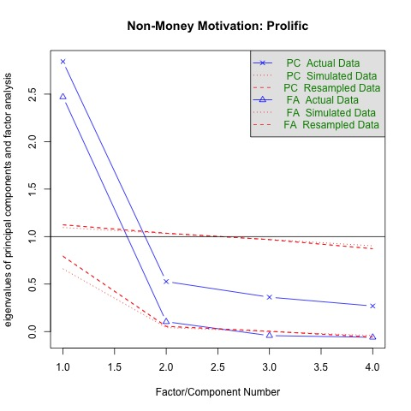
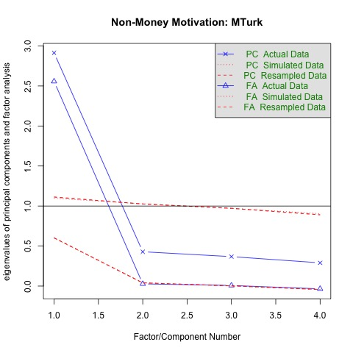
Notes:
These are fancy scree plots for factor analyses conduced on these items for prolific and mturk. As you can see, one eigen value explains the lions share of the variance.

Slide 39
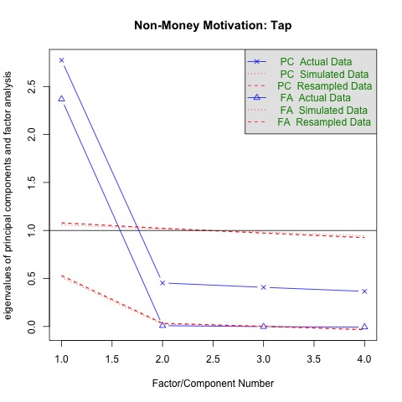
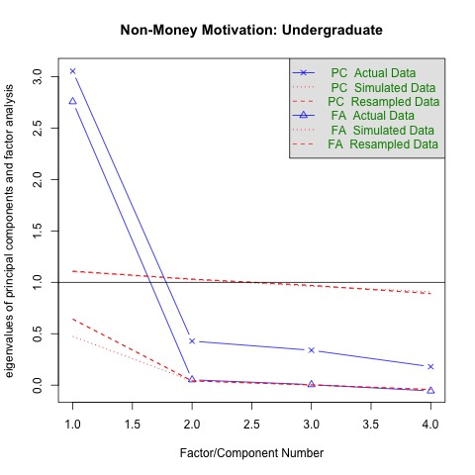
Notes:
These scree plots are surprisingly similar across samples. Loadings are also comparable. All this suggests a single factor common across items and is consistent with a similar intrinsic motivation factor across samples.

Slide 40
Undergraduates report lower intrinsic motivations for taking surveys.
Notes:
Now we can meaningfully compare means across groups. Undergraduates report lower intrinsic motivations for taking surveys.

Slide 41
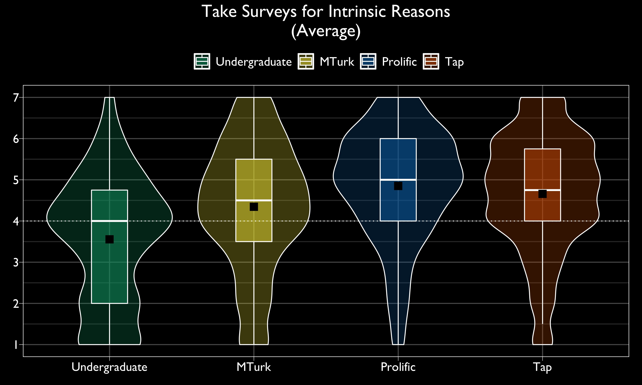
Notes:
Explain slowly.

Slide 42
Taking surveys for money or credit
Undergraduates are more motivated by credit.
MTurk & Prolific are similarly motivated by money.
Notes:
Now I’m going to compare responses for the remaining motivation items. As you might expect, Undergraduates are more motivated by credit, and MTurk & Prolific are similarly motivated by money.

Slide 43
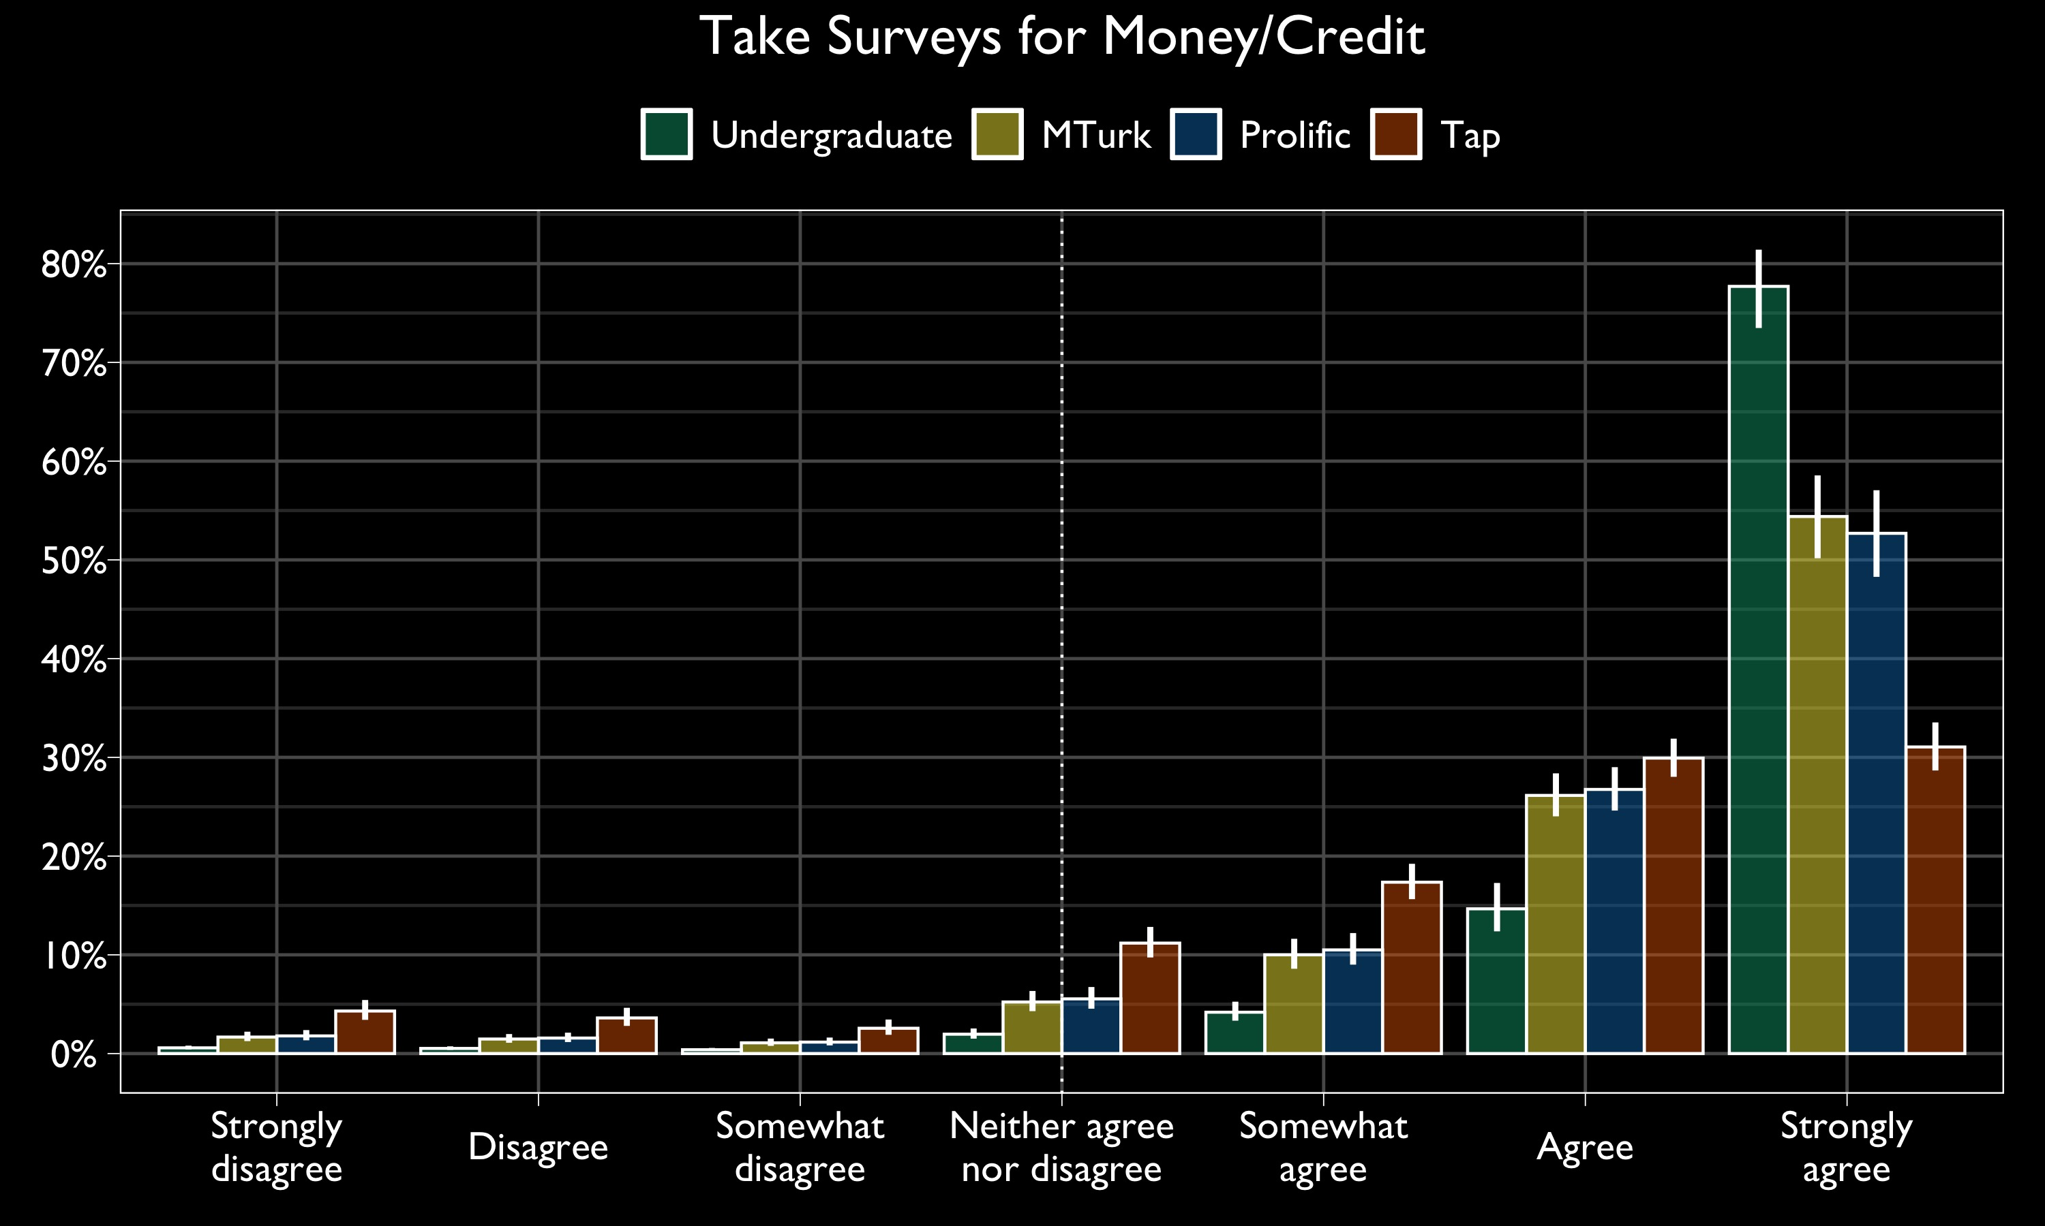
95% Confidence Intervals (Profile)
Notes:
Explain slowly.

Slide 44
Taking Surveys to Kill Time
Undergraduates endorse “time-killing” less strongly than participants from other sources.
MTurkers endorse “time-killing” more strongly than Prolific participants.
Notes:
For the killing time item, Undergraduates endorse “time-killing” less strongly than participants from other sources, and MTurkers endorse “time-killing” more strongly than Prolific participants.

Slide 45
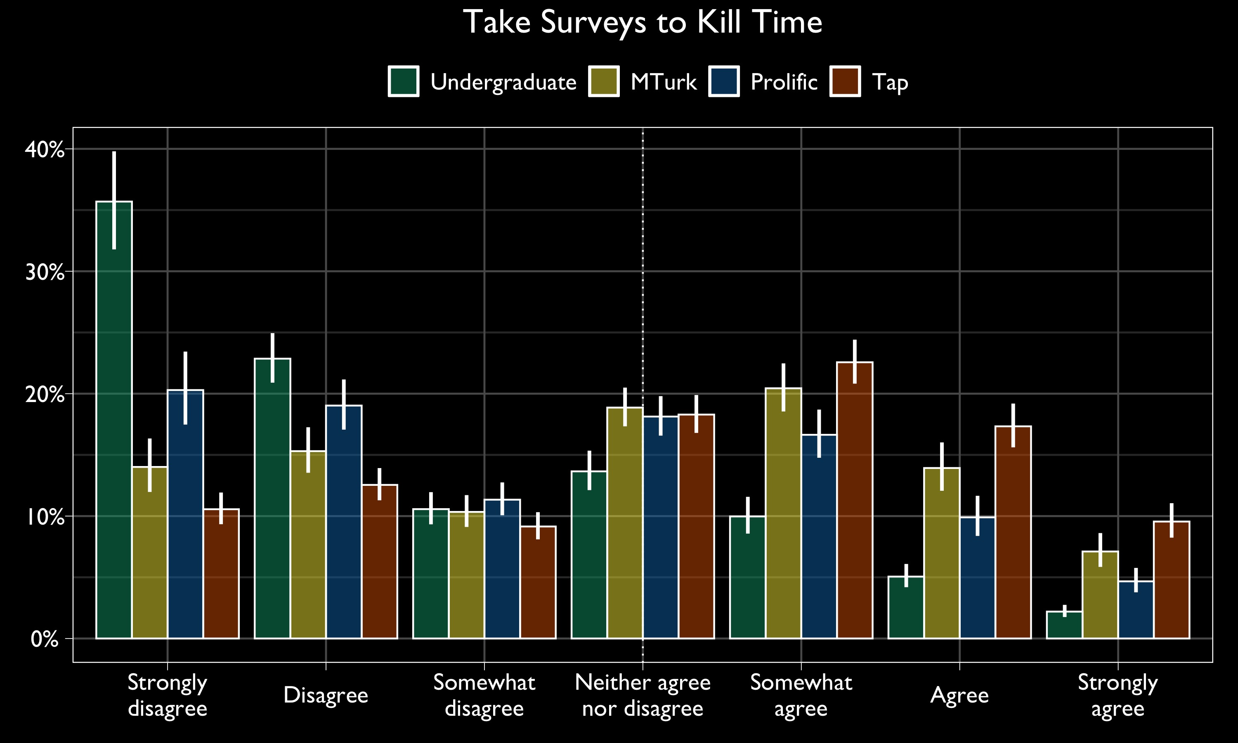
95% Confidence Intervals (Profile)

Slide 46
Score Card
 | Undergraduate | MTurk | Prolific | Tap
Intrinsic Motivation | ⚠️ | ✅ | ✅ | ✅
Extrinsic Motivation | ⚠️ | ❓ | ❓ | ❓
Straightlineing | ❓ | ❓ | ❓ | ❓
Rounding | ❓ | ❓ | ❓ | ❓
Word Count | ❓ | ❓ | ❓ | ❓
Primacy | ❓ | ❓ | ❓ | ❓
Speeding | ❓ | ❓ | ❓ | ❓
Missing Data | ❓ | ❓ | ❓ | ❓
Reliability | ❓ | ❓ | ❓ | ❓
Notes:
I gave undergraduates a concern triangle because they they score relatively low on intrinsic motivation and highly on extrinsic motivation. You might score things a little differently. I’m just doing it for fun for now but I’d love to hear your thoughts.

Slide 47
Straightlining
Tap participants straightlined the most.
Prolific participants straightlined the least.
Notes:
Next comes straightlinging. Tap participants straightlined the most. Prolific participants straightlined the least.

Slide 48
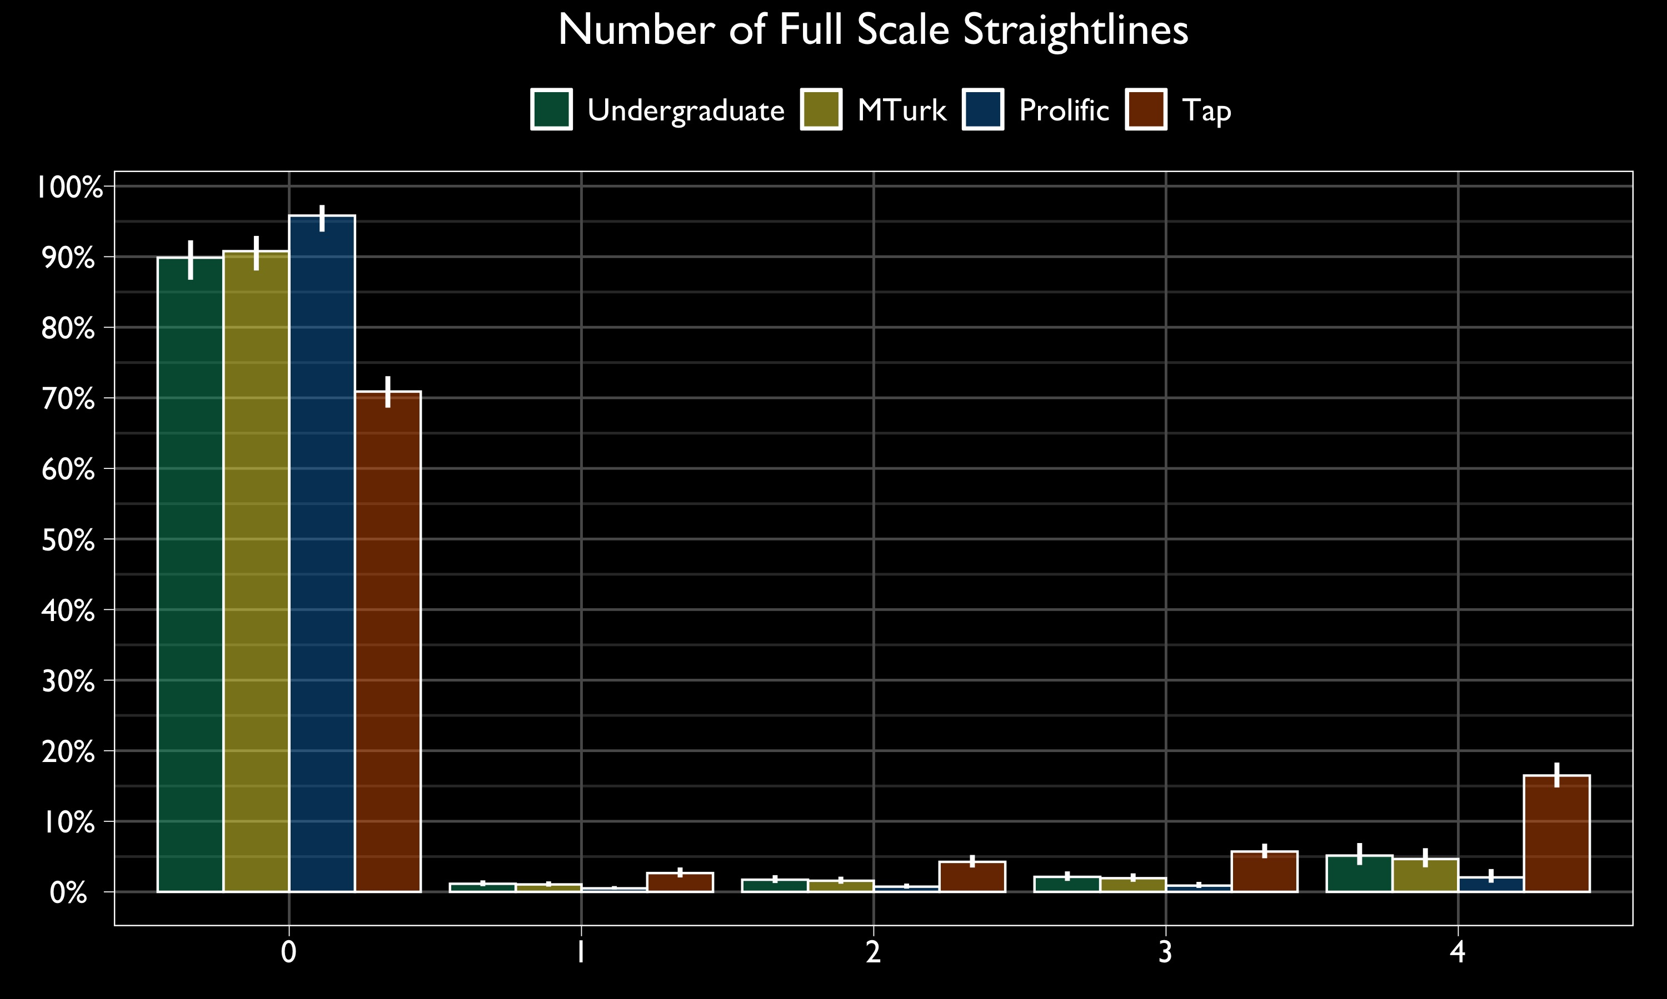
95% Confidence Intervals (Profile)
Notes:
Most participants didn’t straightline at all. Slowly explain.

Slide 49
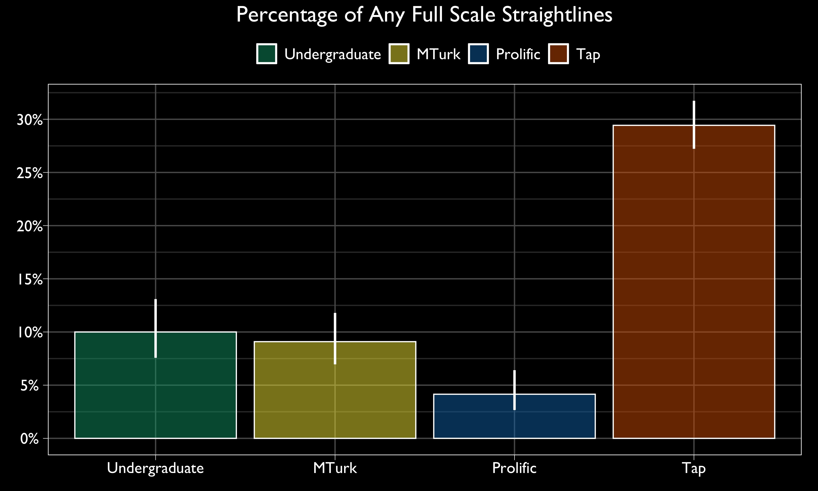
95% Confidence Intervals (Profile)
Notes:
Slowly explain.

Slide 50
Score Card
 | Undergraduate | MTurk | Prolific | Tap
Intrinsic Motivation | ⚠️ | ✅ | ✅ | ✅
Extrinsic Motivation | ⚠️ | ❓ | ❓ | ❓
Straightlineing | ❓ | ❓ | ✅ | ⚠️
Rounding | ❓ | ❓ | ❓ | ❓
Word Count | ❓ | ❓ | ❓ | ❓
Primacy | ❓ | ❓ | ❓ | ❓
Speeding | ❓ | ❓ | ❓ | ❓
Missing Data | ❓ | ❓ | ❓ | ❓
Reliability | ❓ | ❓ | ❓ | ❓
Notes:
I gave Prolific a green check and Tap a concerned triangle.

Slide 51
Round Numeric Estimates
Participants gave round, numeric estimates similarly across sources.
Notes:
Participants gave round, numeric estimates similarly across sources.

Slide 52
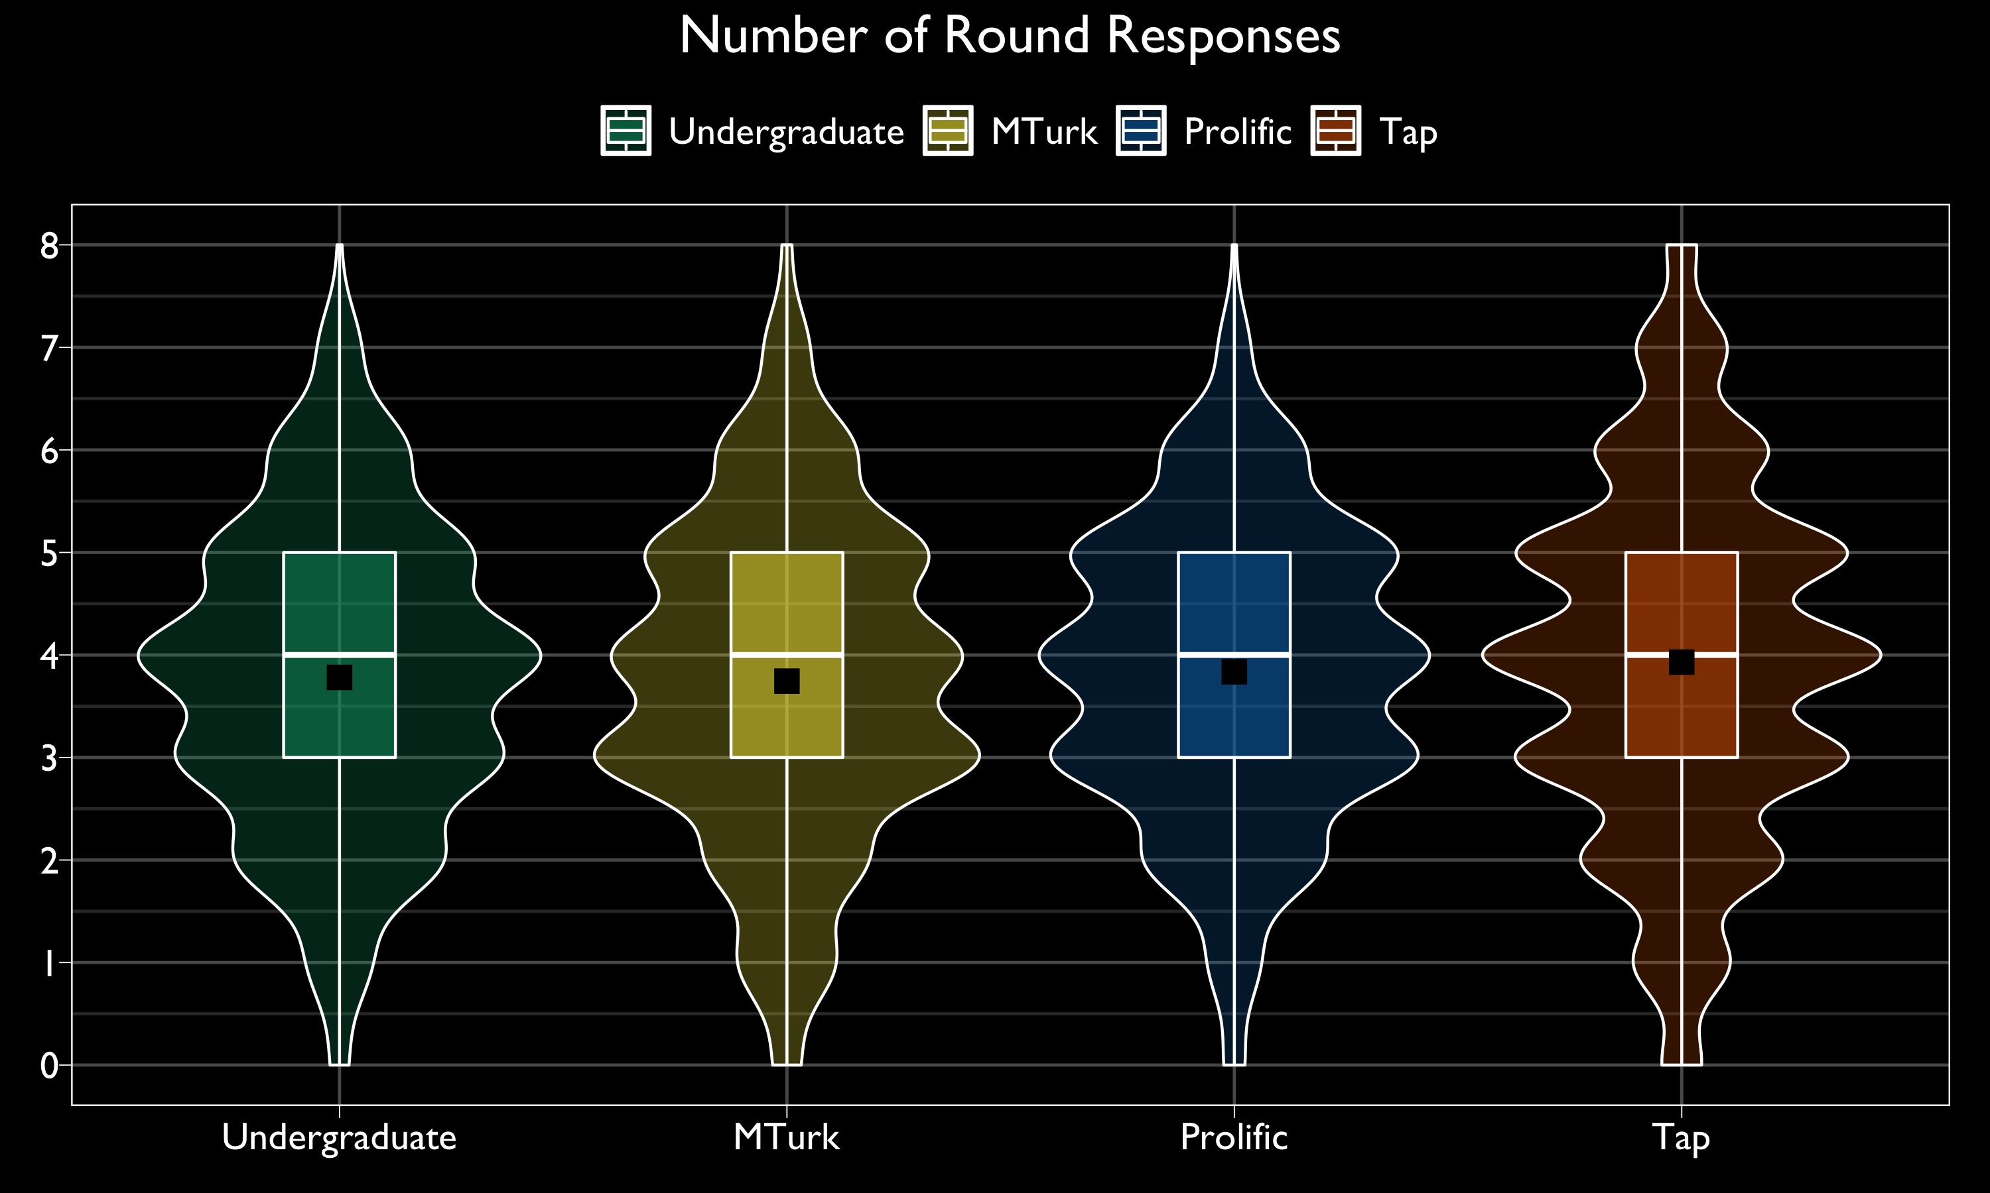
Notes:
Explain slowly.

Slide 53
Score Card
 | Undergraduate | MTurk | Prolific | Tap
Intrinsic Motivation | ⚠️ | ✅ | ✅ | ✅
Extrinsic Motivation | ⚠️ | ❓ | ❓ | ❓
Straightlineing | ❓ | ❓ | ✅ | ⚠️
Rounding | ✅ | ✅ | ✅ | ✅
Word Count | ❓ | ❓ | ❓ | ❓
Primacy | ❓ | ❓ | ❓ | ❓
Speeding | ❓ | ❓ | ❓ | ❓
Missing Data | ❓ | ❓ | ❓ | ❓
Reliability | ❓ | ❓ | ❓ | ❓
Notes:
Green checks all around!

Slide 54
Open Response Word Count
Tap participants wrote fewer words than participants from other sources.
Notes:
Tap participants wrote fewer words than participants from other sources.

Slide 55
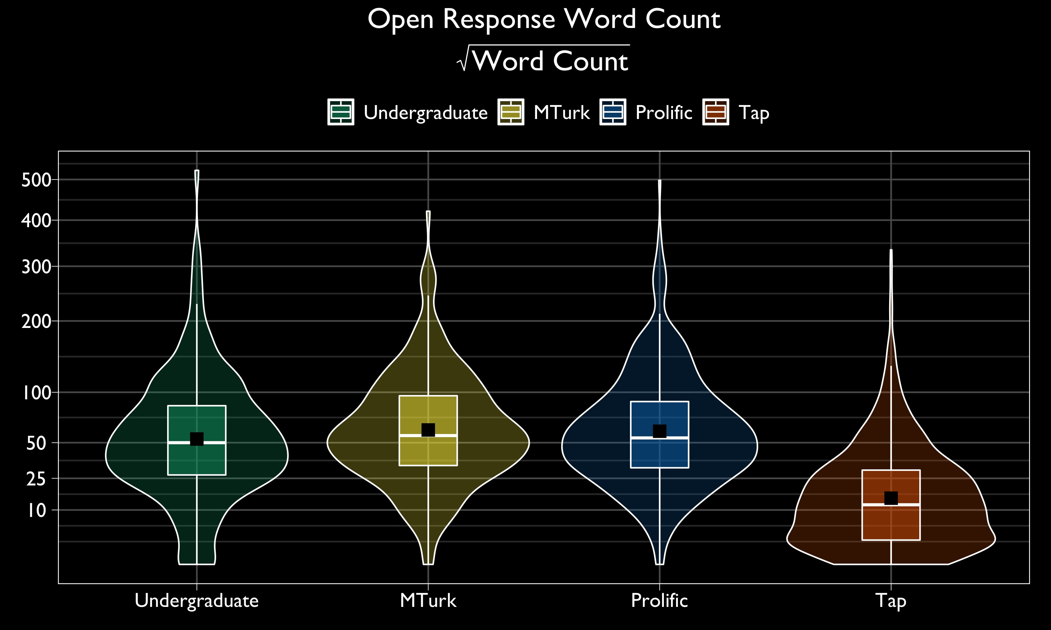
Notes:
Explain slowly. Typically wrote 50 words (not tap).

Slide 56
95% Confidence Intervals (Profile)
Notes:
Explain slowly.

Slide 57
Score Card
 | Undergraduate | MTurk | Prolific | Tap
Intrinsic Motivation | ⚠️ | ✅ | ✅ | ✅
Extrinsic Motivation | ⚠️ | ❓ | ❓ | ❓
Straightlineing | ❓ | ❓ | ✅ | ⚠️
Rounding | ✅ | ✅ | ✅ | ✅
Word Count | ❓ | ❓ | ✅ | ⚠️
Primacy | ❓ | ❓ | ❓ | ❓
Speeding | ❓ | ❓ | ❓ | ❓
Missing Data | ❓ | ❓ | ❓ | ❓
Reliability | ❓ | ❓ | ❓ | ❓
Notes:
I’m giving tap a concerned triangle and Prolific a green check because so few word counts were ten or below.

Slide 58
Primacy
We found no evidence for a primacy effect.
List order did not significantly change the proportion times a quality was listed as a top 3 child quality.
Notes:
We found no support for a primacy effect, probably because of them content.

Slide 59
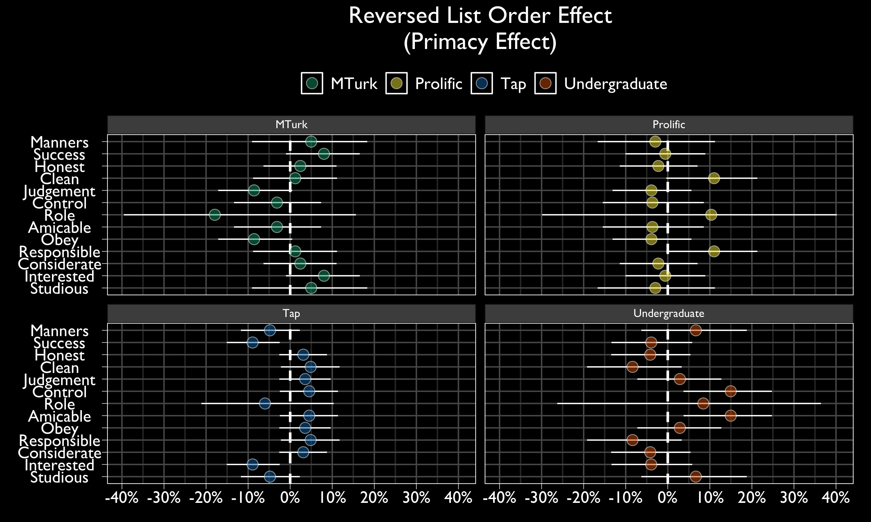
Notes:
Explain slowly.

Slide 60
Score Card
 | Undergraduate | MTurk | Prolific | Tap
Intrinsic Motivation | ⚠️ | ✅ | ✅ | ✅
Extrinsic Motivation | ⚠️ | ❓ | ❓ | ❓
Straightlineing | ❓ | ❓ | ✅ | ⚠️
Rounding | ✅ | ✅ | ✅ | ✅
Word Count | ❓ | ❓ | ✅ | ⚠️
Primacy | ❓ | ❓ | ❓ | ❓
Speeding | ❓ | ❓ | ❓ | ❓
Missing Data | ❓ | ❓ | ❓ | ❓
Reliability | ❓ | ❓ | ❓ | ❓
Notes:
Red questions all around.

Slide 61
Milliseconds per Word
Among finished surveys, most participants spent between 350 and 800 milliseconds per word (on average).
MTurkers spent the least time per word.
Undergraduates spent the most time per word.
Notes:
Next is milliseconds per word. Most participants completed these questions at a plausible reading speed.

Slide 62
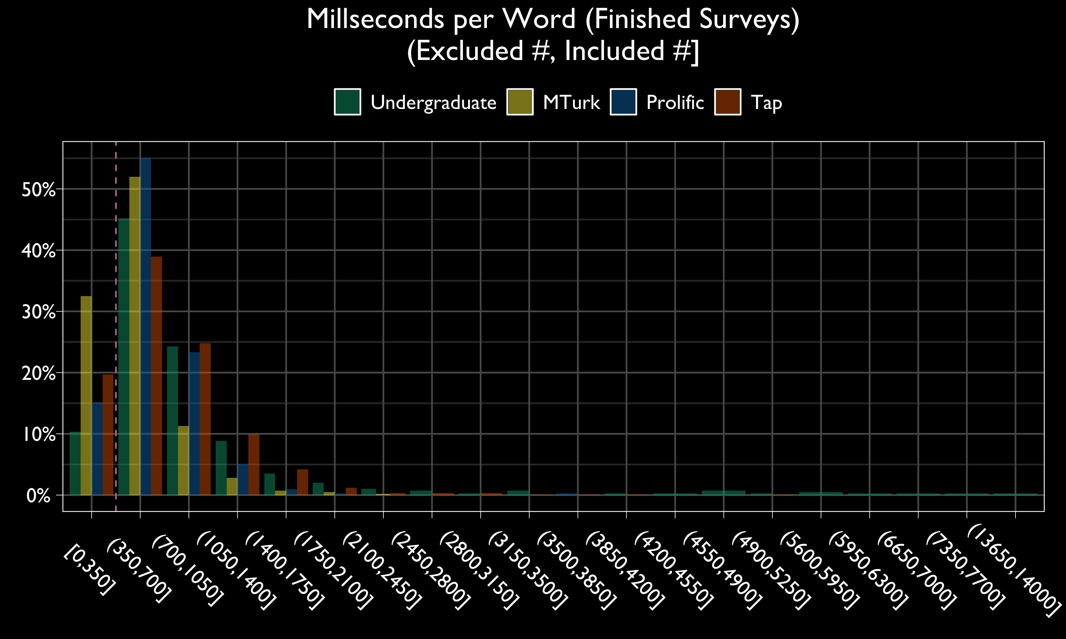
Notes:
Explain slowly.

Slide 63
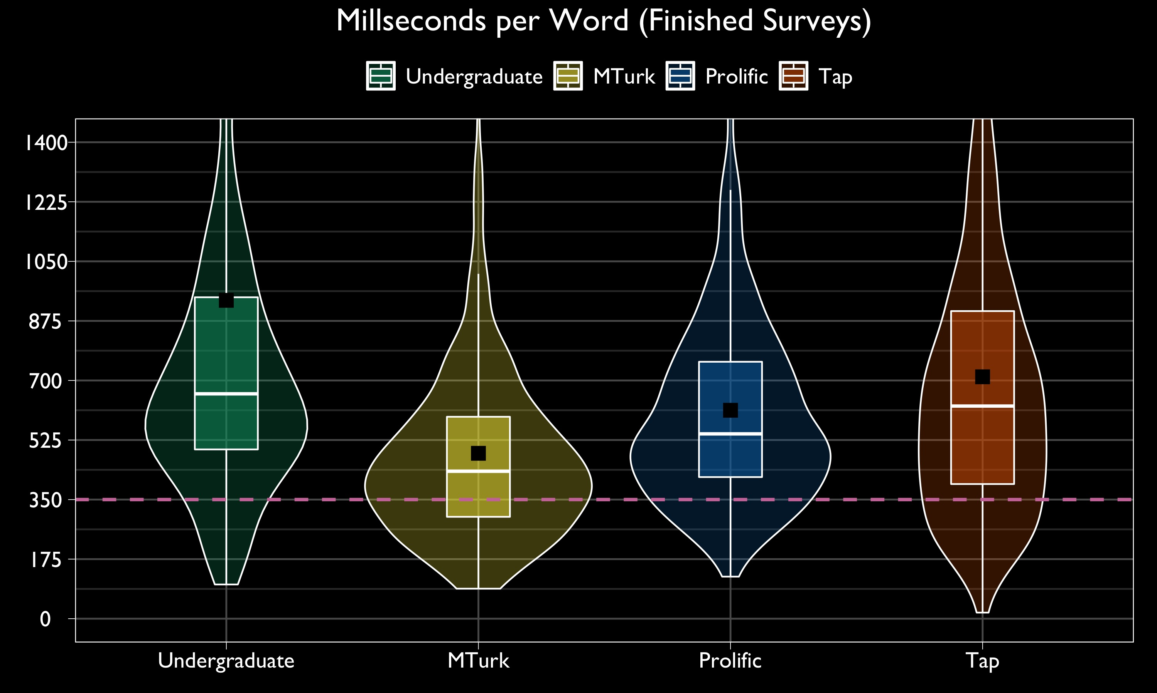
Notes:
Explain slowly.

Slide 64
Score Card
 | Undergraduate | MTurk | Prolific | Tap
Intrinsic Motivation | ⚠️ | ✅ | ✅ | ✅
Extrinsic Motivation | ⚠️ | ❓ | ❓ | ❓
Straightlineing | ❓ | ❓ | ✅ | ⚠️
Rounding | ✅ | ✅ | ✅ | ✅
Word Count | ❓ | ❓ | ✅ | ⚠️
Primacy | ❓ | ❓ | ❓ | ❓
Speeding | ❓ | ⚠️ | ❓ | ❓
Missing Data | ❓ | ❓ | ✅ | ⚠️
Reliability | ❓ | ❓ | ❓ | ❓
Notes:
This is maybe unfair, but I’m giving Mturk a concerned triangle because so many participants completed their survey at such a breakneck base.

Slide 65
Seen but Unanswered Questions
Most participants completed questions if they saw them.
Even Tap participants (though they left the highest average percentage unanswered).

Slide 66
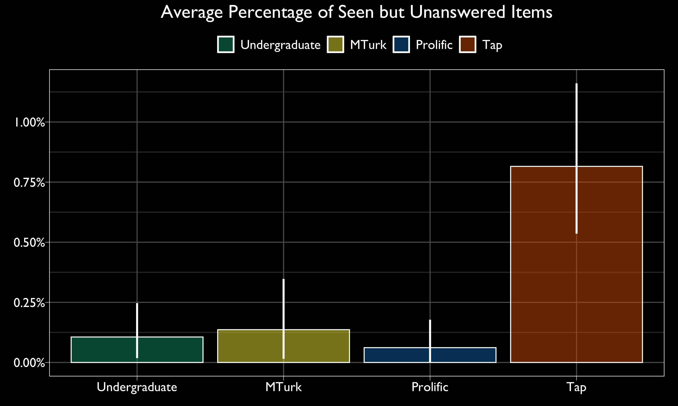
95% Confidence Intervals (Bootstrap)
Notes:
Explain slowly.

Slide 67
Unseen questions
Tap participants left the most questions unseen.
Prolific participants left the least.

Slide 68
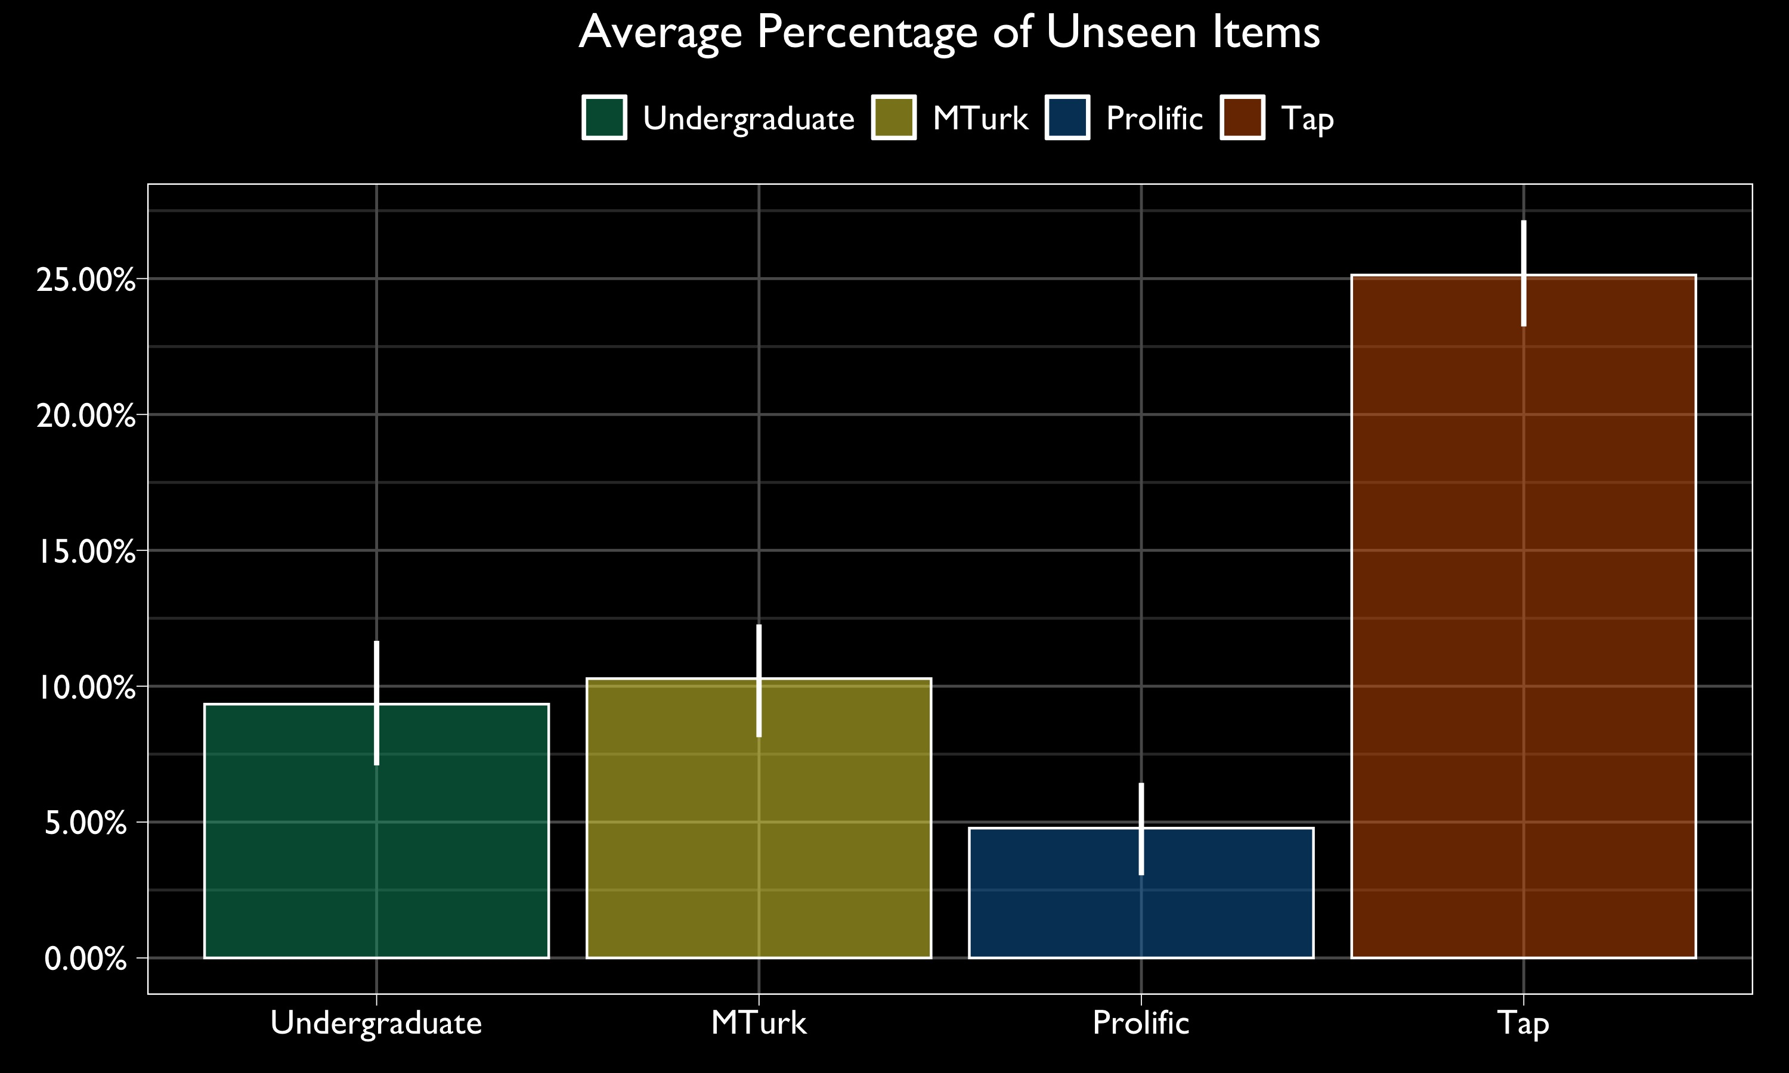
95% Confidence Intervals (Profile)
Notes:
Explain slowly.

Slide 69
Score Card
 | Undergraduate | MTurk | Prolific | Tap
Intrinsic Motivation | ⚠️ | ✅ | ✅ | ✅
Extrinsic Motivation | ⚠️ | ❓ | ❓ | ❓
Straightlineing | ❓ | ❓ | ✅ | ⚠️
Rounding | ✅ | ✅ | ✅ | ✅
Word Count | ❓ | ❓ | ❓ | ⚠️
Primacy | ❓ | ❓ | ❓ | ❓
Speeding | ✅ | ⚠️ | ✅ | ✅
Missing Data | ❓ | ❓ | ✅ | ⚠️
Reliability | ❓ | ❓ | ❓ | ❓
Notes:
Tap gets yet another concerned triangle. Prolific has posted some impressive non-missing data stats.

Slide 70
Popular Scale Reliabilities
Tap inter-item correlations within scales were relatively low (on average).
Undergraduates inter-item correlations were surprisingly low.
Low inter-item correlations explained between-source differences in reliability.

Slide 71
Coefficient Alpha
$$\frac{n_{items}r_{average}}{1+ \left(n_{items}−1\right)r_{average}}$$
Notes:
Explain slowly.

Slide 72
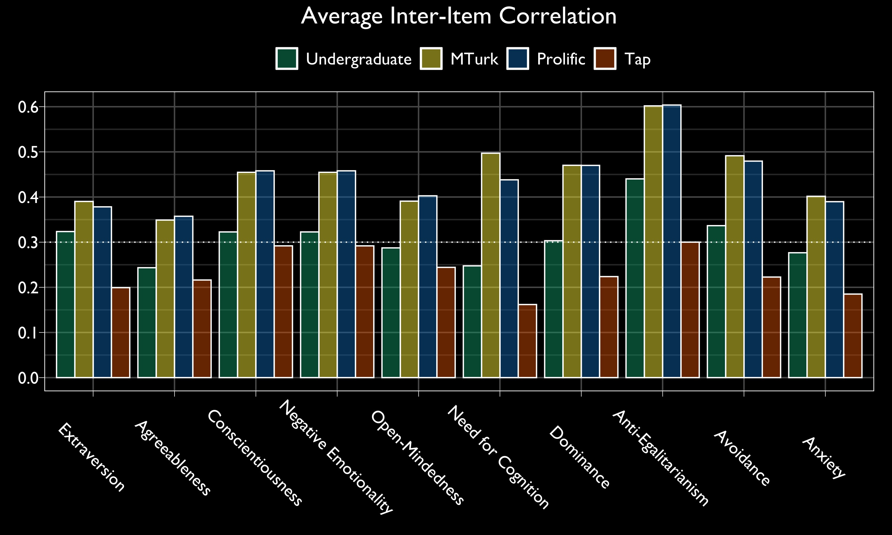
Notes:
Explain slowly.

Slide 73
McDonald’s Omega
$$\frac{Correlations explained by a General Factor}{Original Correlations}$$
Notes:
Explain slowly.

Slide 74
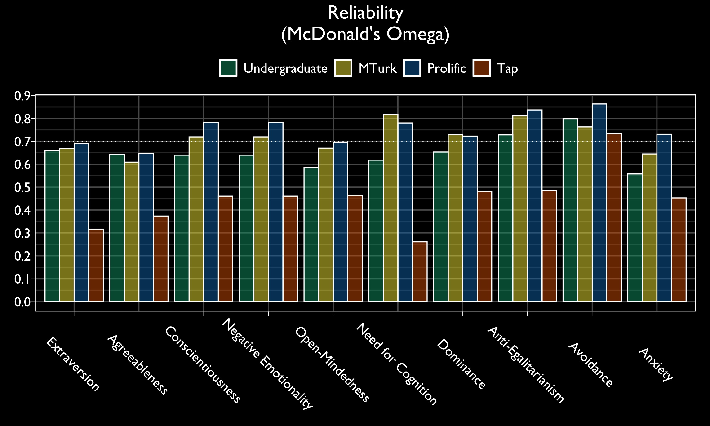
Notes:
Explain slowly.

Slide 75
Score Card
 | Undergraduate | MTurk | Prolific | Tap
Intrinsic Motivation | ⚠️ | ✅ | ✅ | ✅
Extrinsic Motivation | ⚠️ | ❓ | ❓ | ❓
Straightlineing | ❓ | ❓ | ✅ | ⚠️
Rounding | ✅ | ✅ | ✅ | ✅
Word Count | ❓ | ❓ | ❓ | ⚠️
Primacy | ❓ | ❓ | ❓ | ❓
Speeding | ✅ | ⚠️ | ✅ | ✅
Missing Data | ❓ | ❓ | ✅ | ⚠️
Reliability | ⚠️ | ✅ | ✅ | ⚠️
Notes:
Tap gets its final concerned triangle, and so do the undergraduates.

Slide 76
More intrinsically motivated participants satisfice less

Slide 77
They’re less likely to straightline

Slide 79
They write more words in their essays

Slide 80
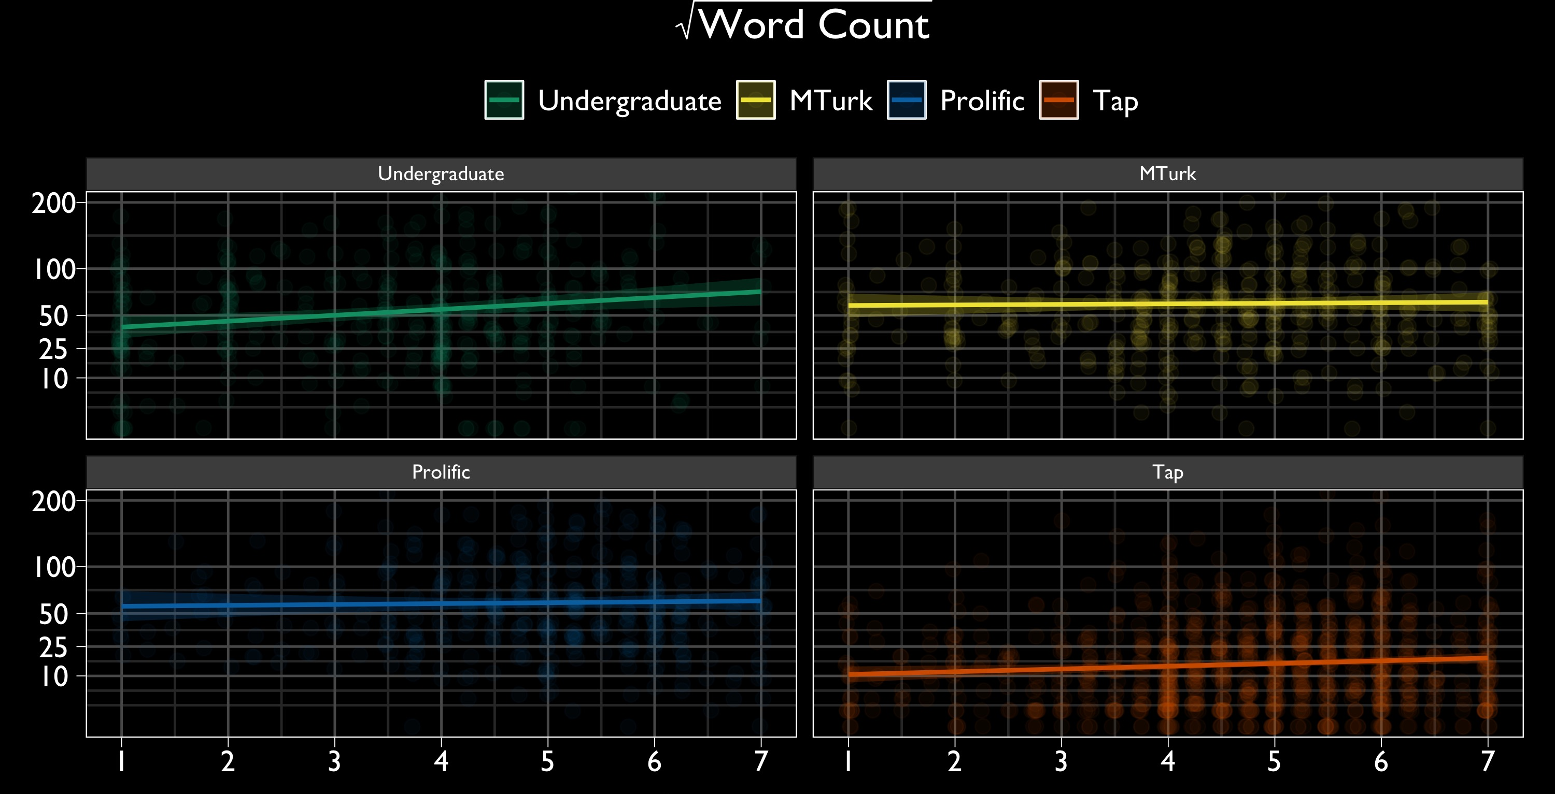

Slide 81
And the respond more consistently within widely used scales

Slide 82
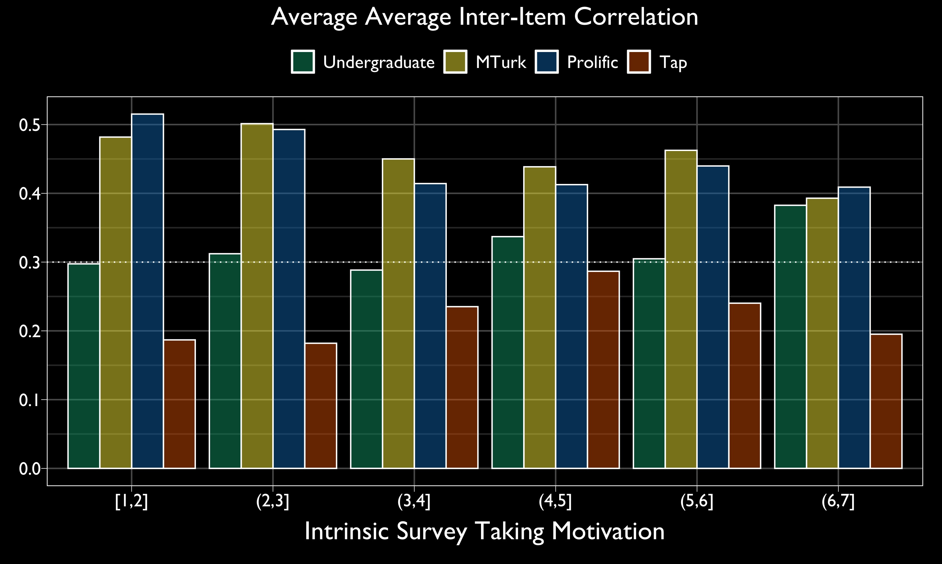

Slide 83
Collaborators
Todd Chan
Dr. Fred Conrad

Slide 84
Take this with you
People from four different samples varied in their intrinsic motivations to take surveys.
Intrinsic motivations were associated with less satisficing (thus higher data quality).
MTurk and Prolific participants provided the best quality data.
Tap participants did not.

Slide 85
Thank you nickmichalak.com

Slide 86
Self-Reported Engagement
When I take surveys on MTurk, I feel bursting with energy.
I find that the responses I give on MTurk surveys are full of meaning and purpose.
Time flies when I am taking surveys on MTurk.
When I take surveys on MTurk, I feel strong and vigorous.
I am enthusiastic about the surveys I take on MTurk.
When I am taking surveys on MTurk, I forget everything else around me.
Taking surveys on MTurk inspires me.
When I get up in the morning, I feel like taking surveys on MTurk.
I feel happy when I am intensely taking surveys on MTurk.
I am proud of the MTurk survey responses that I give.
I am immersed in the MTurk surveys that I take.
I can continue taking MTurk surveys for very long periods at a time.
To me, MTurk surveys are challenging.
I get carried away when I am taking MTurk surveys.
When I am taking MTurk surveys, I am very resilient, mentally.
It is difficult to detach myself from taking MTurk surveys.
When I take MTurk surveys, I always persevere, even when things do not go well.

Slide 87
Survey Engagement means different things to participants from different sources.

Slide 88
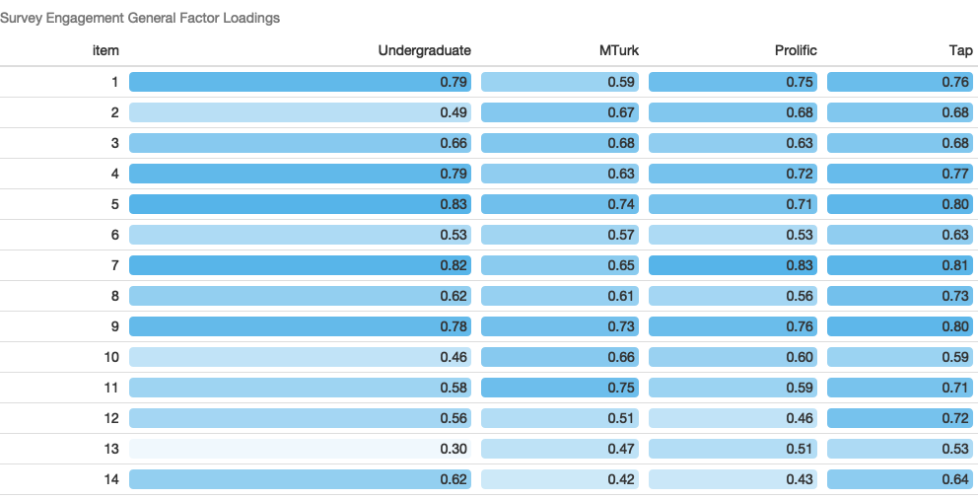

Slide 89
“Predictive Invariance?”
The engagement construct varies across sources.
But it consistently correlates with intrinsic motivations.

Slide 90
95% Confidence Intervals

Slide 91
Correlations with Money/Credit and Time Killing motivations are mixed

Slide 92
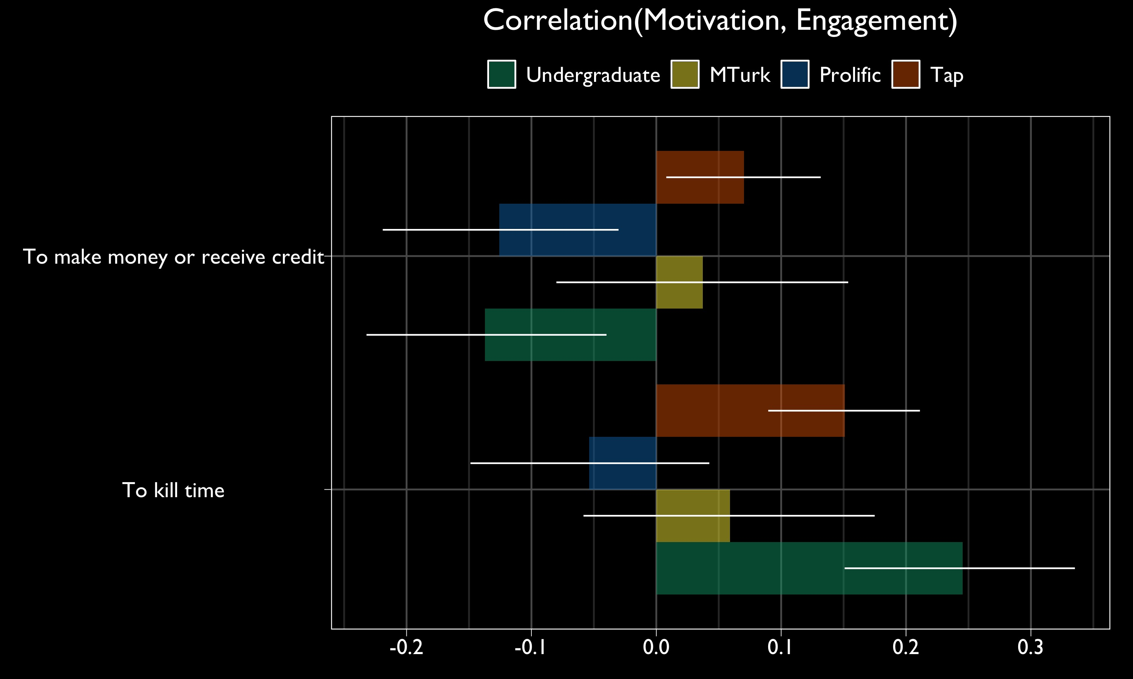
95% Confidence Intervals

